Slide 1
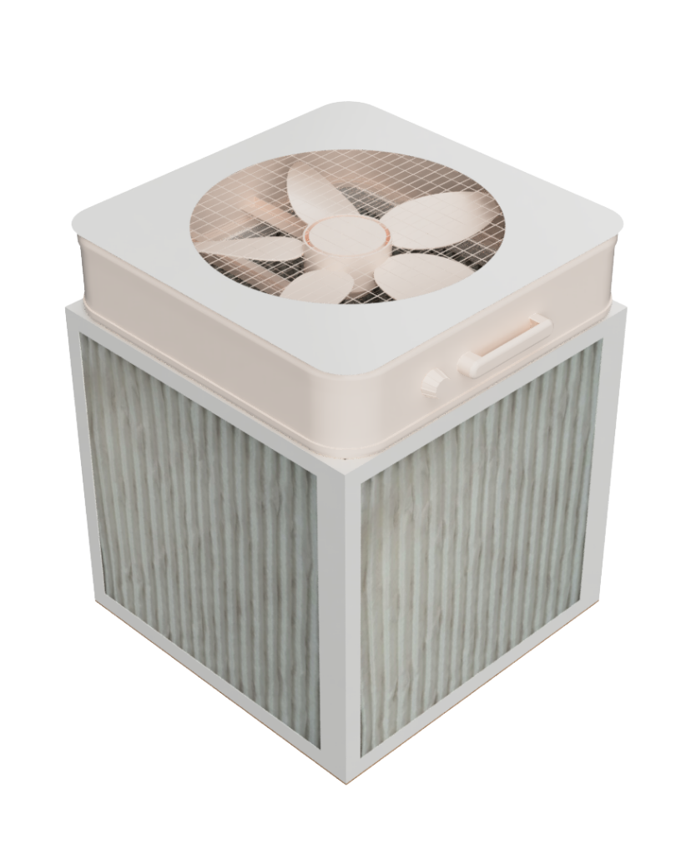
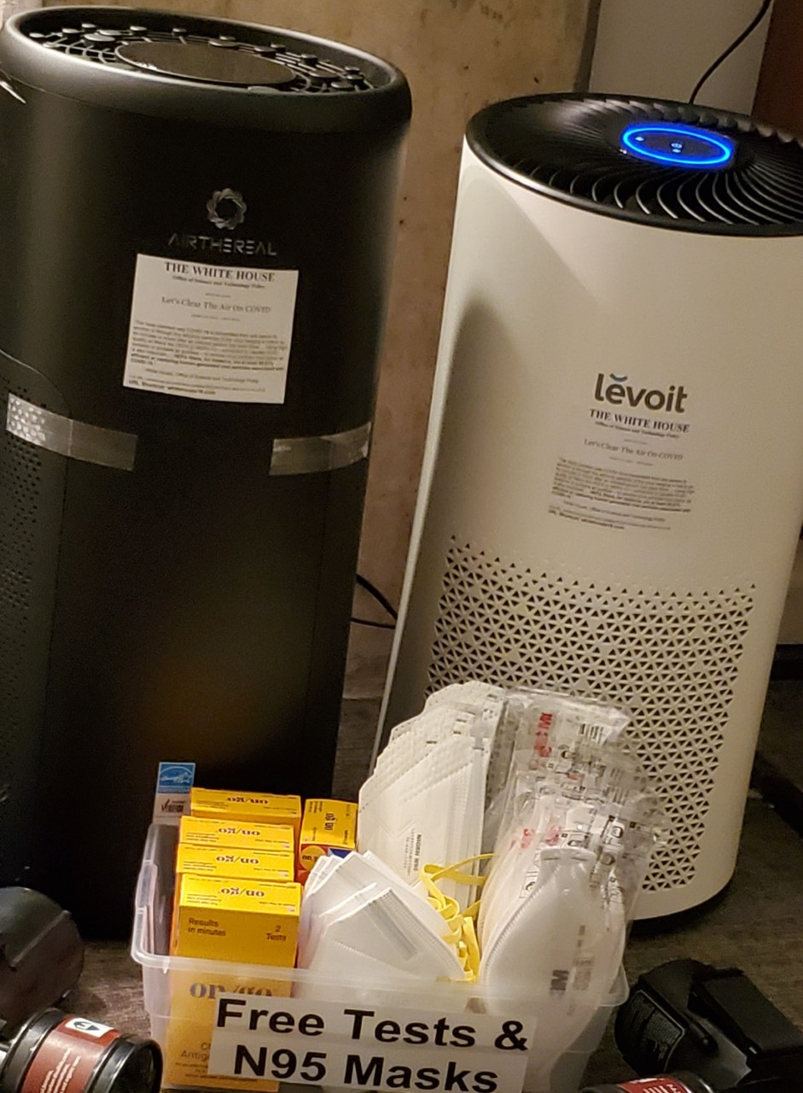
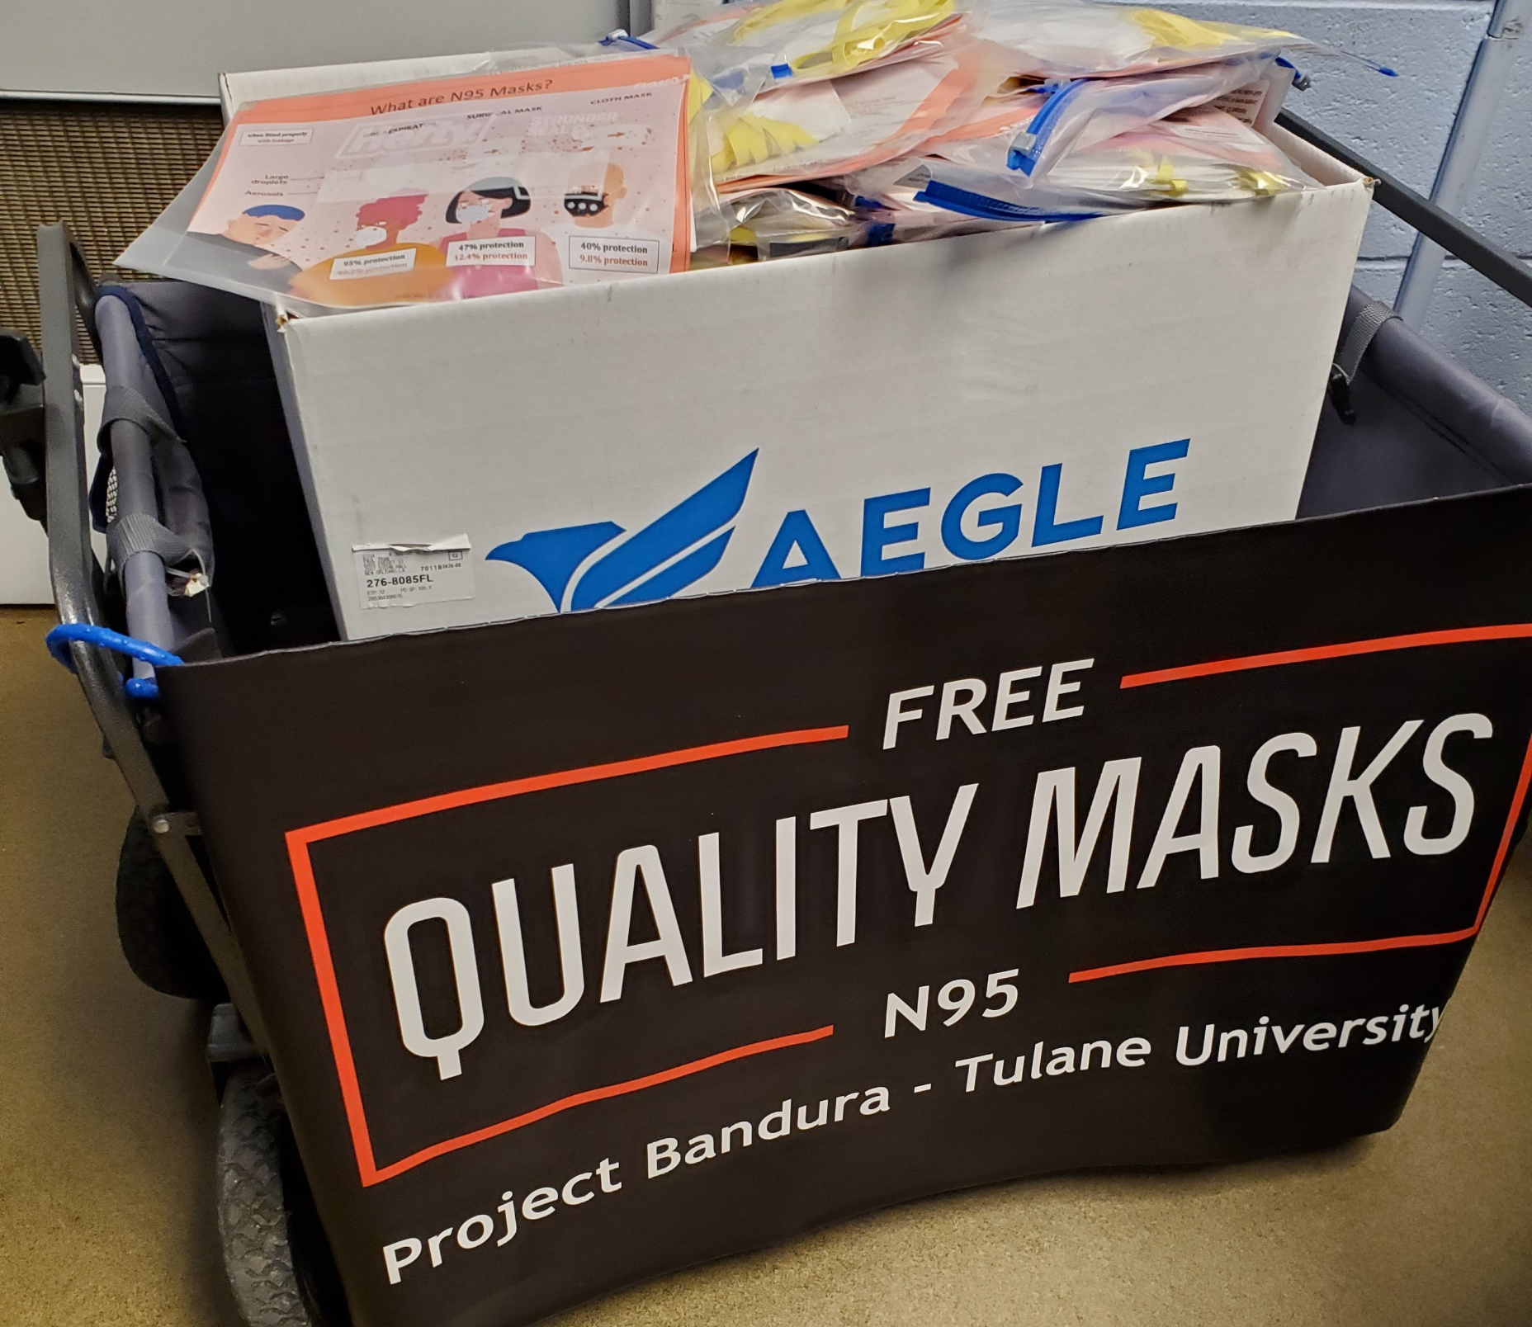
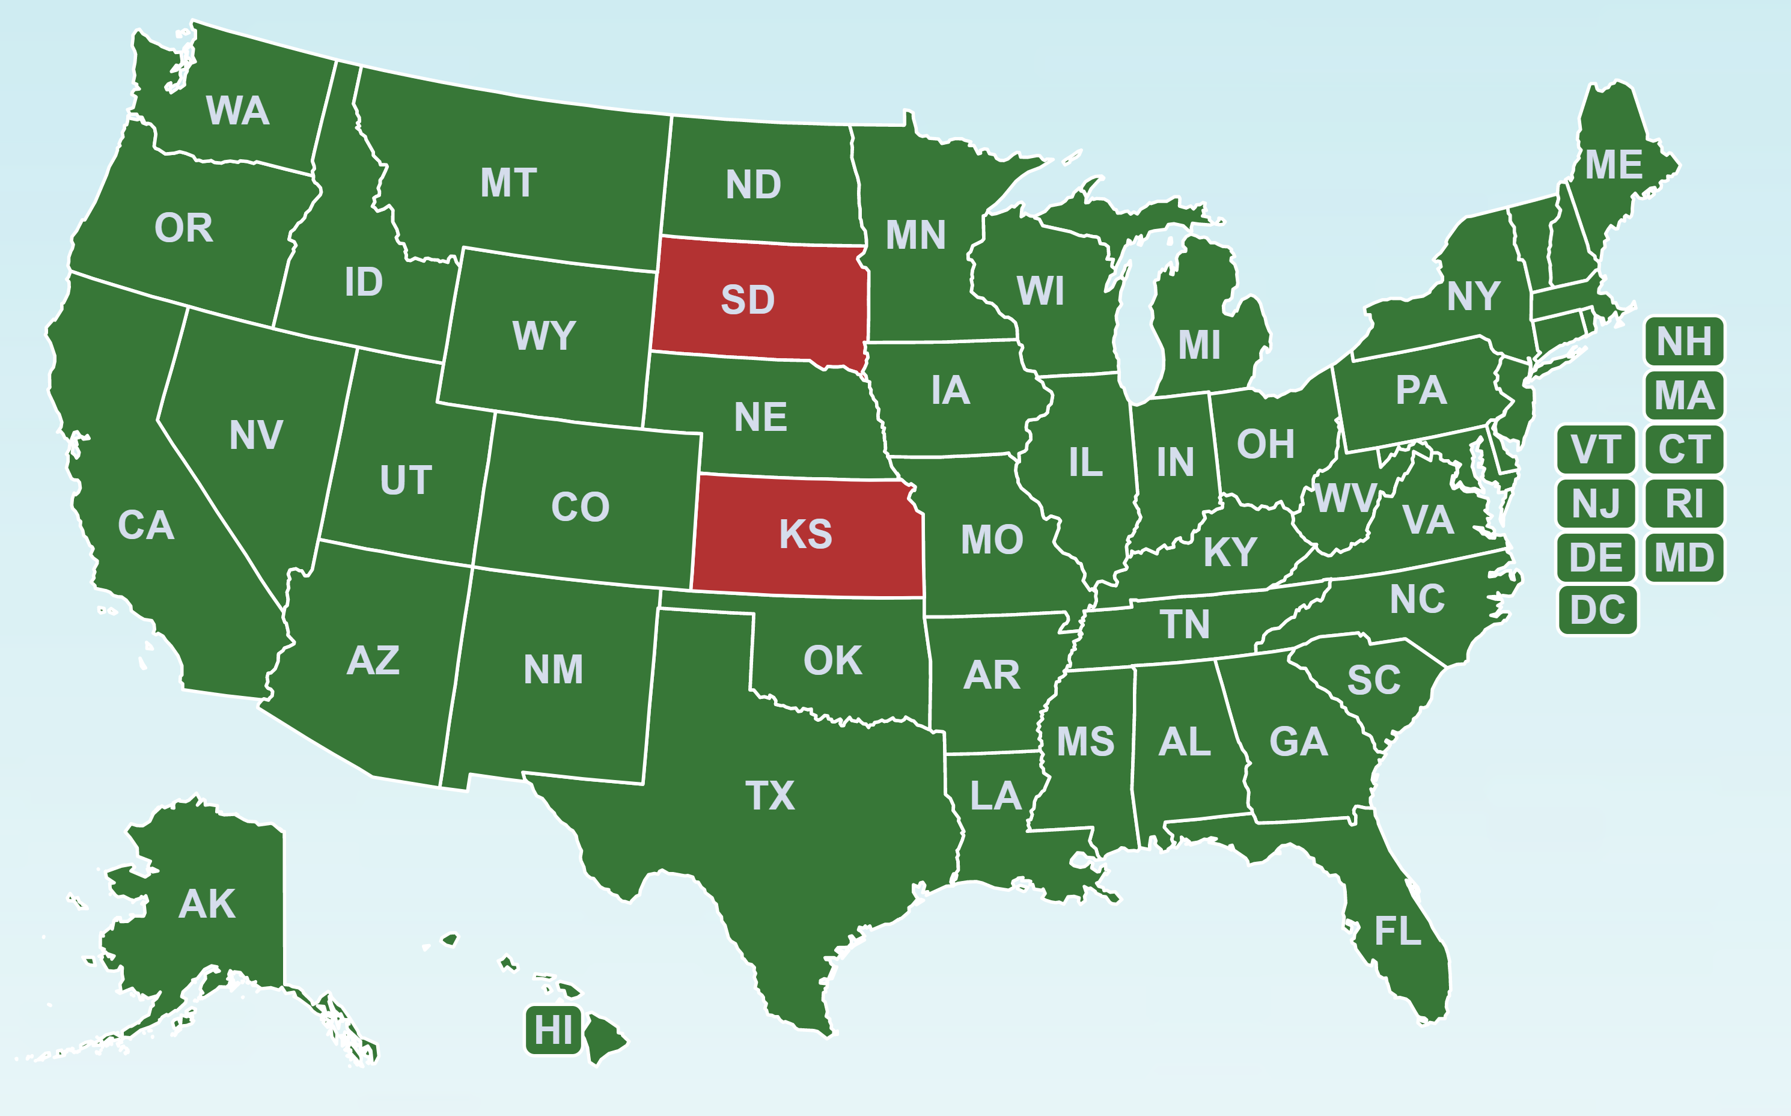
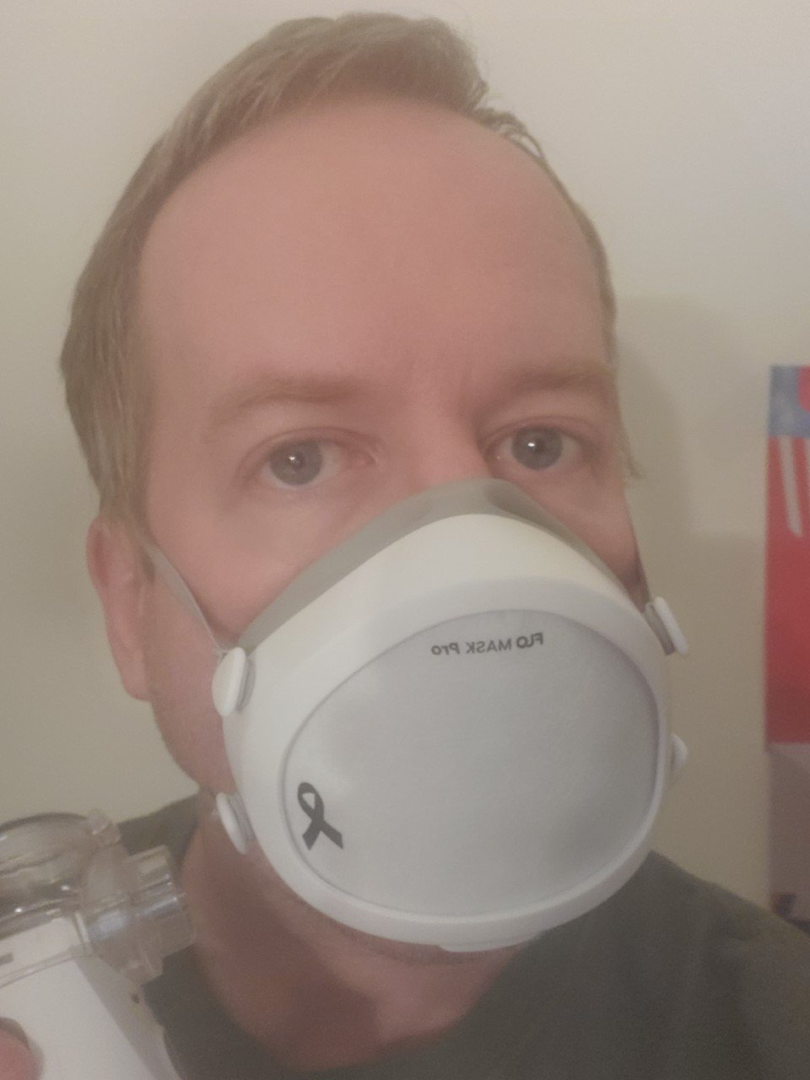
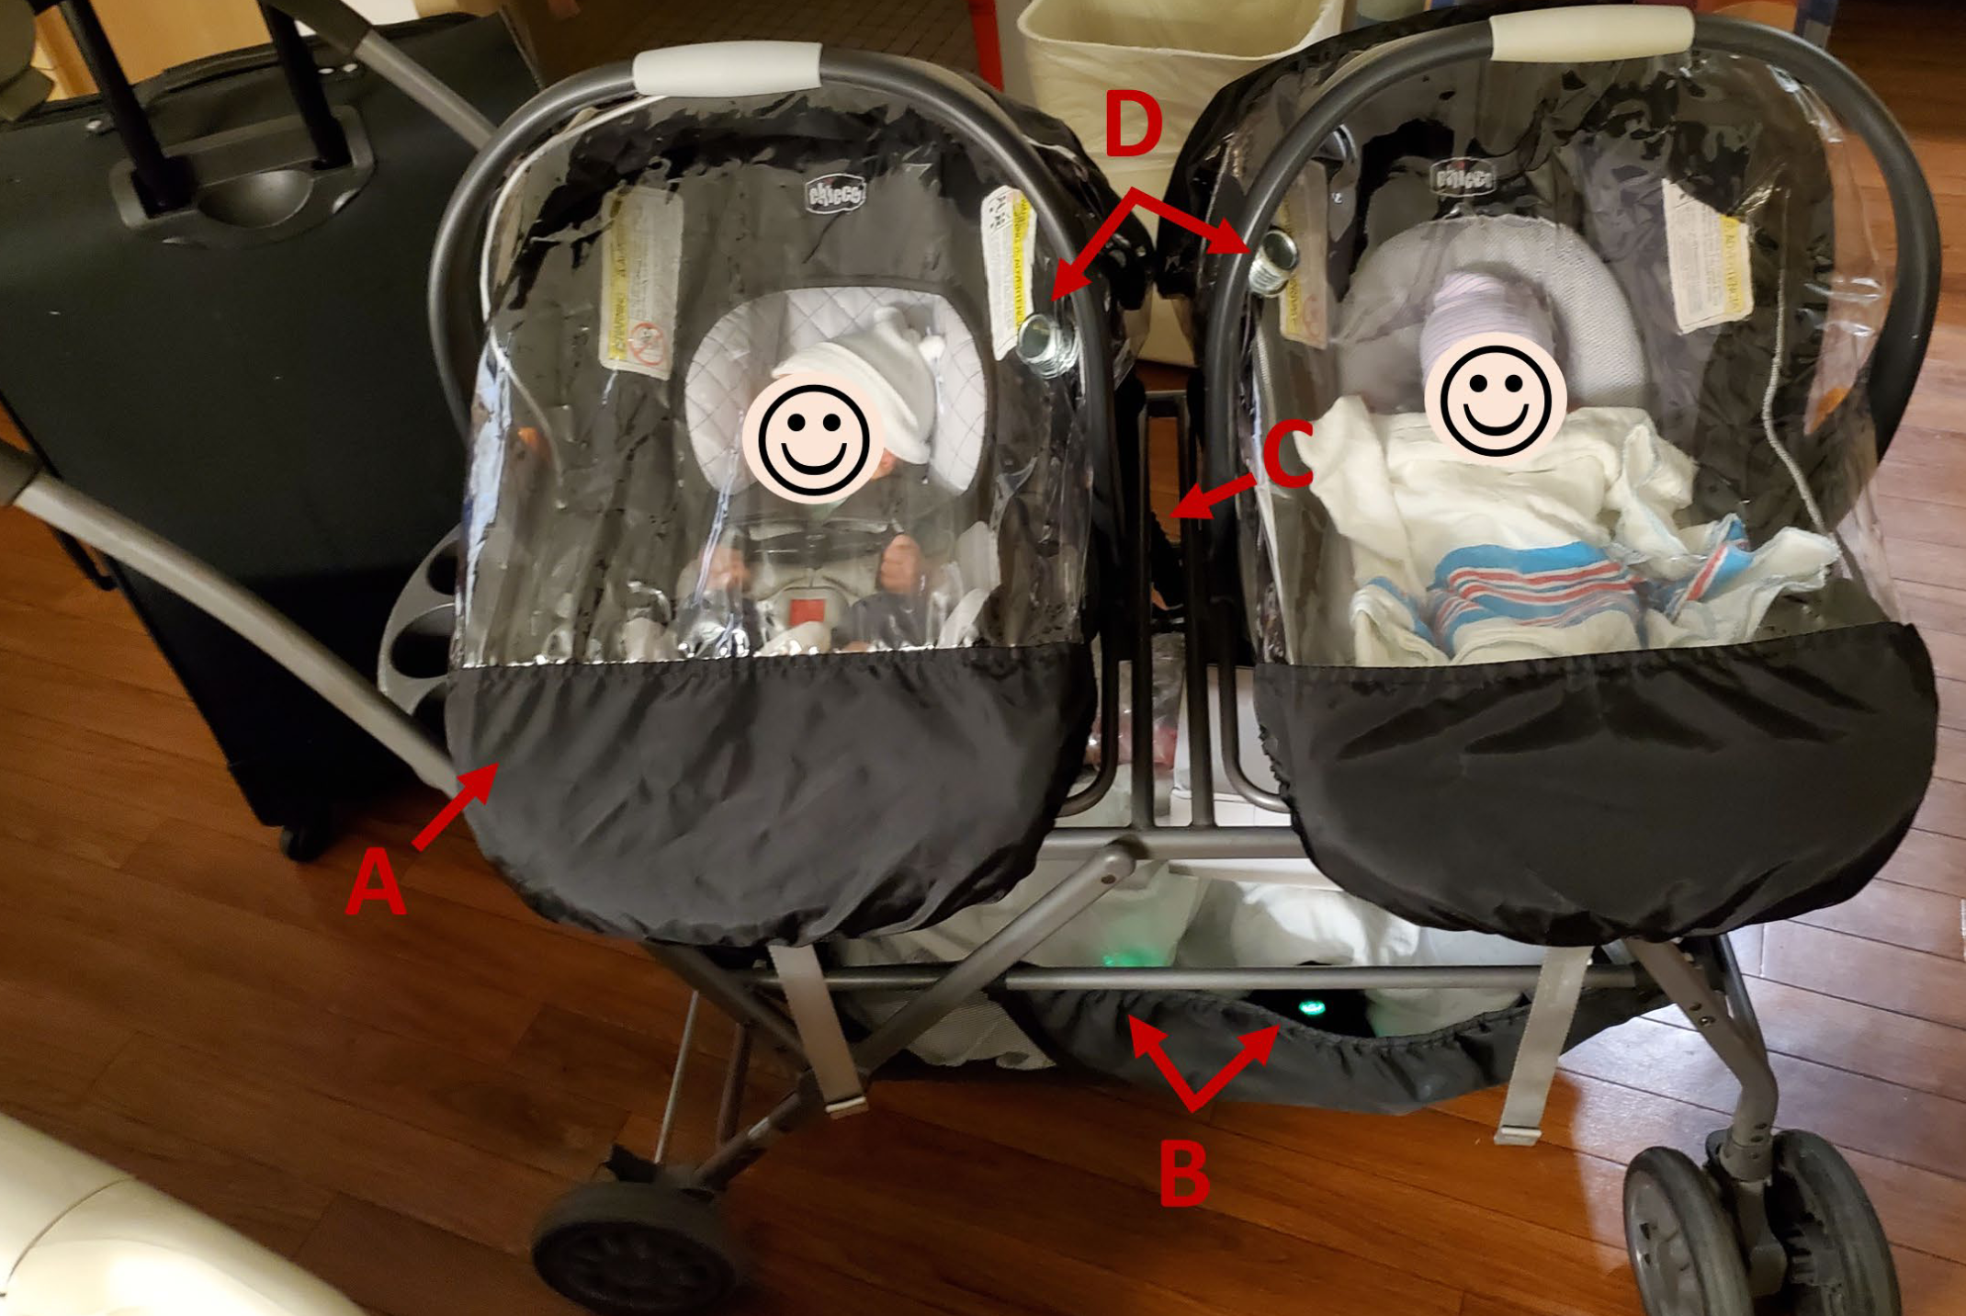
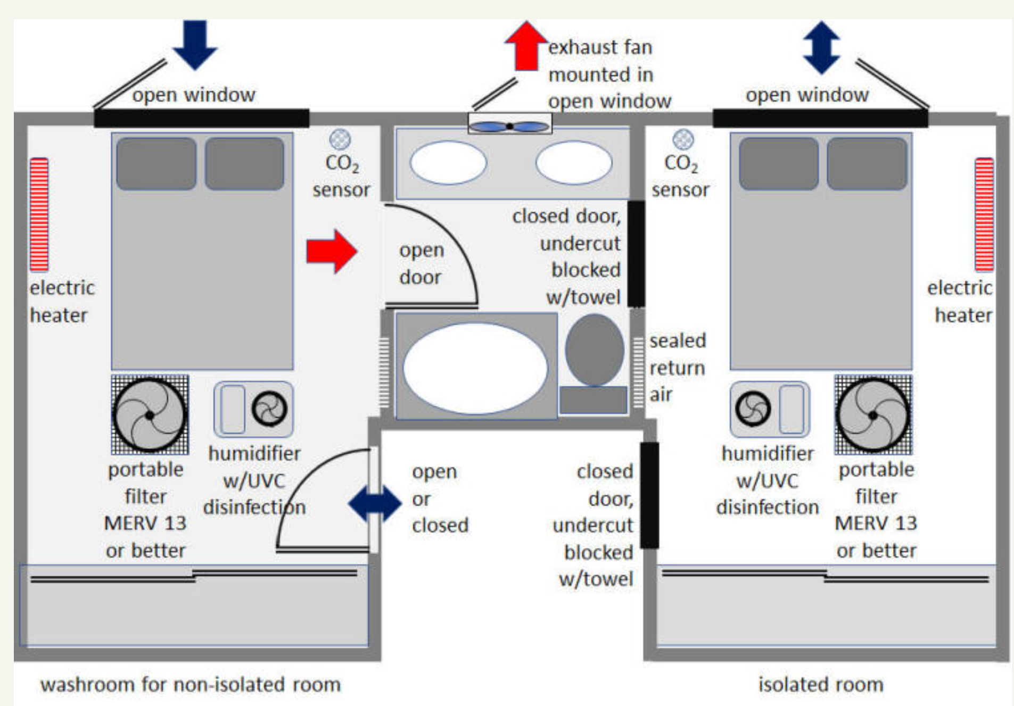
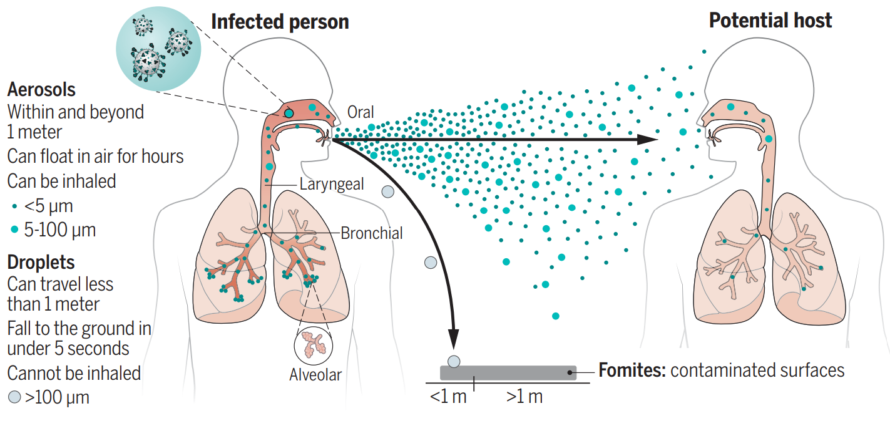
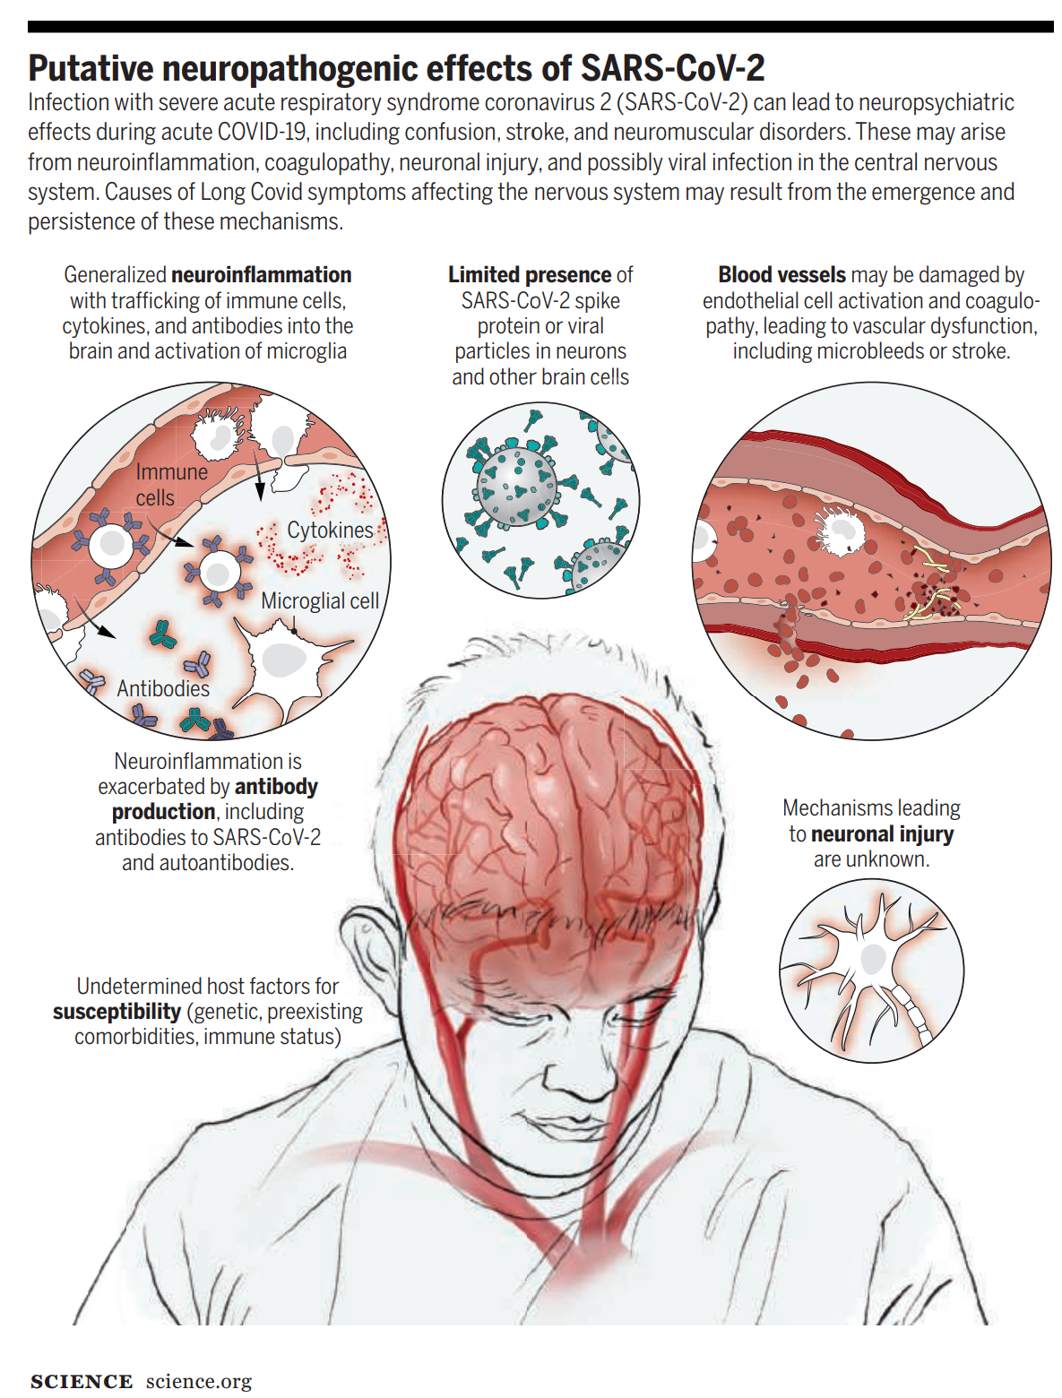
Surviving the COVID-19 Pandemic: Things I Have Learned (So Far) Michael Hoerger, PhD, MSCR, MBA
Notes:
The title pays homage to Jacob Cohen’s (1990) statistical primer, “Things I have Learned (So Far)”
https://tech.me.holycross.edu/files/2015/03/Cohen_1990.pdf

Slide 2
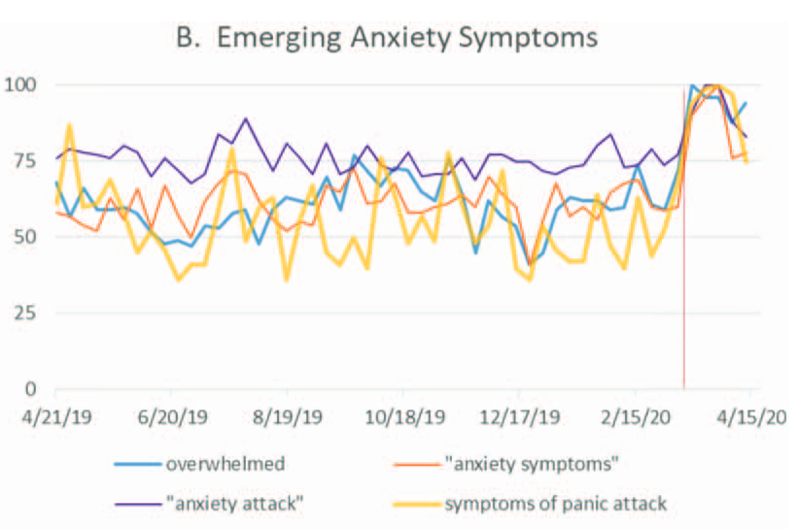
Notes:
http://kreweofstrength.com/
http://masknola.com/
http://nola19.com/
http://www.psych-onc.com/publications.php?tag=Pandemic
https://pubmed.ncbi.nlm.nih.gov/36547943/

Slide 3
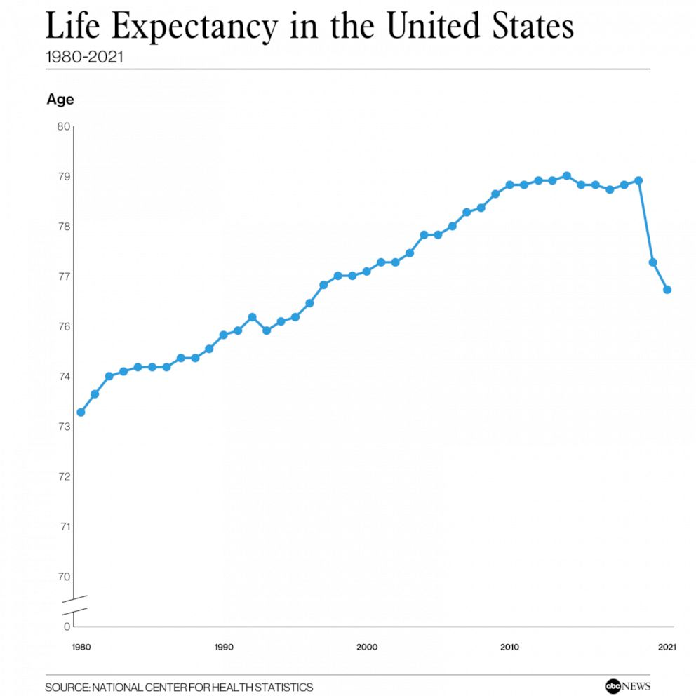
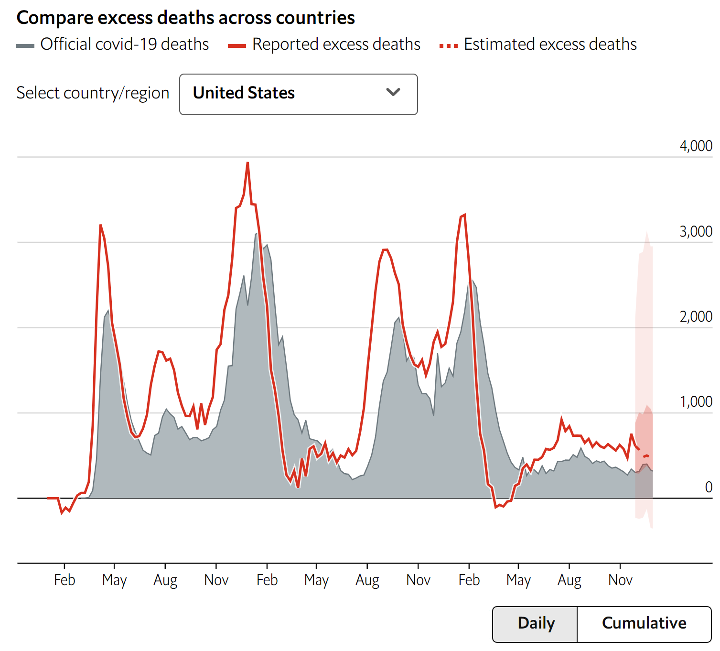
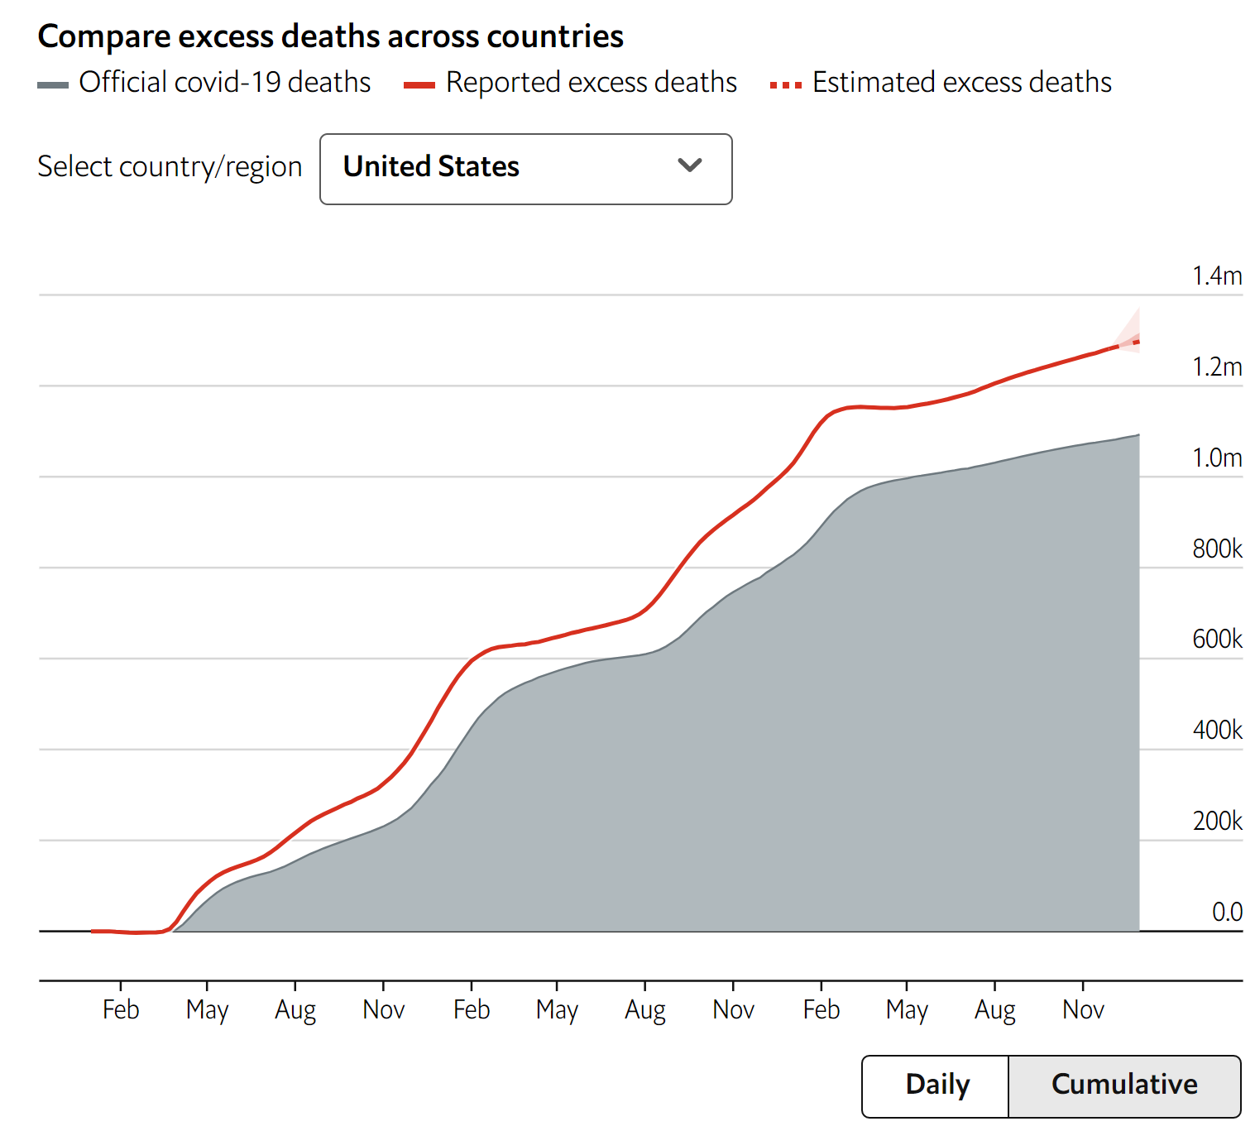
COVID-19 is NOT “A Cold or the Flu”
1 in 26 Americans dead or bereaving the loss of a close family member
Notes:
https://www.economist.com/graphic-detail/coronavirus-excess-deaths-estimates
26 = 332,000,000 / (1,300,000 * 10)
My own excess death calculations suggest more like 1 in 21
21 = 332,000,000 / (1,600,000 * 10)
https://abcnews.go.com/Health/us-life-expectancy-falls-lowest-levels-1996-due/story?id=95649464

Slide 4
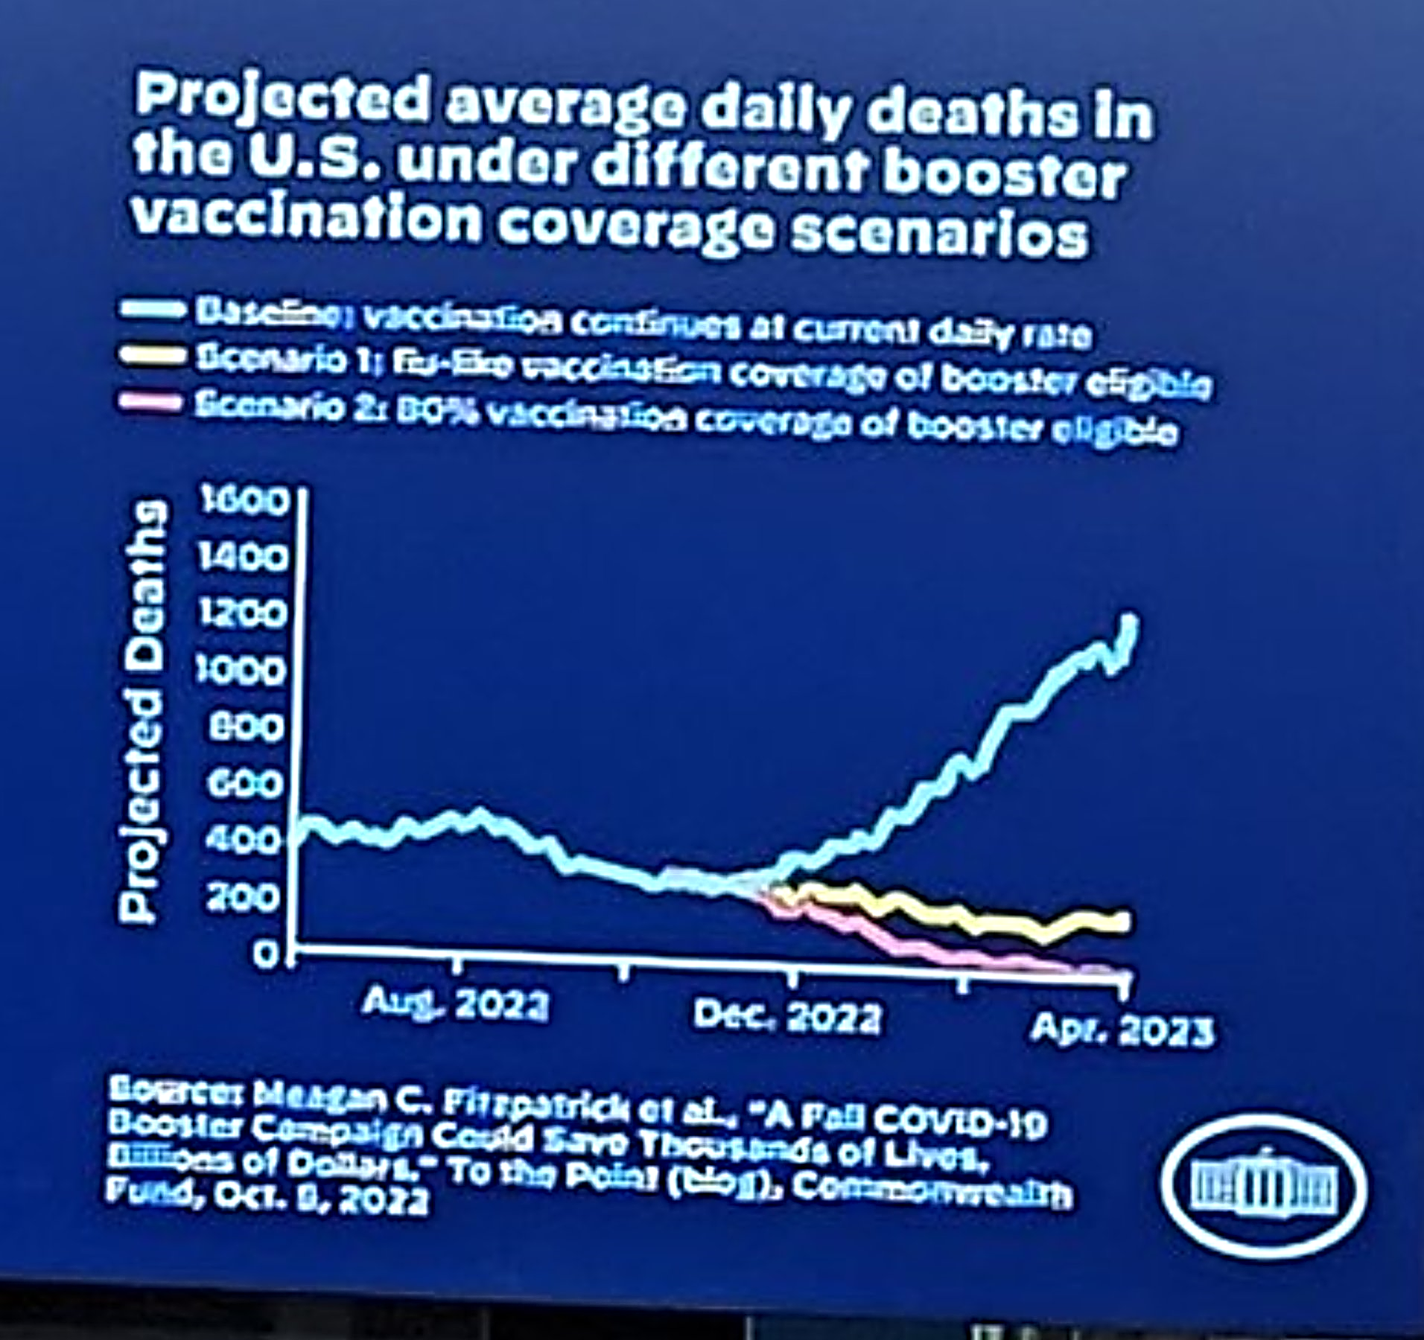
COVID-19 is NOT “A Cold or the Flu”
Notes:
https://twitter.com/robcrilly/status/1579918363488550912/photo/1
Cancer Death Statistics:
ACS Facts & Figures 2022
609,360 deaths per year / 365 days = 1,669 deaths/day

Slide 5
COVID-19 is NOT “A Cold or the Flu”
1 in 5 (5%-40%) prevalence of Long COVID
1.5-2 million fewer Americans working
Multi-system damage
Respiratory
Brain
Cardiovascular
Immune dysregulation
Harms persist
Impacts children & adults
Notes:
Prevalence (one estimate of many available sources)
https://www.cdc.gov/nchs/pressroom/nchs_press_releases/2022/20220622.htm
Labor participation rates down 1%, translating to 1.5-2 million quitting the workforce
https://fred.stlouisfed.org/series/CIVPART
Graph of multi-system damage:
https://www.cdc.gov/mmwr/volumes/71/wr/mm7121e1.htm
Immune dysregulation:
Covid doubling the risk of RSV in children: https://www.medrxiv.org/content/10.1101/2022.11.29.22282887v1
Dysregulation of maternal immune response: https://www.sciencedirect.com/science/article/pii/S2666379121003219
Hybrid immune damping: https://www.science.org/doi/full/10.1126/science.abq1841
Risk persists (article on persistence of symptoms from onset, does not cover newly-emerging long-term effects):
https://jamanetwork.com/journals/jamanetworkopen/fullarticle/2798224
Risks apply to children:
https://www.thelancet.com/journals/lanpsy/article/PIIS2215-0366(22)00260-7/fulltext
https://jamanetwork.com/journals/jamanetworkopen/fullarticle/2800087
https://jamanetwork.com/journals/jamanetworkopen/fullarticle/2800089
https://www.medrxiv.org/content/10.1101/2022.11.29.22282887v1
https://www.cdc.gov/vaccines/acip/meetings/downloads/slides-2022-06-17-18/02-covid-fleming-dutra-508.pdf

Slide 6
COVID-19 is NOT “A Cold or the Flu”
COVID-19 particularly increases the likelihood of vascular (blood vessel) damage, which increases the risk of “brain fog,” confusion, strokes/mini-strokes, weakness, fatigue, sensory issues, changes in heart rate, sexual issues, and bladder issues.
Notes:
https://www.science.org/doi/10.1126/science.abm2052
https://twitter.com/drclairetaylor/status/1595244354133803011

Slide 7
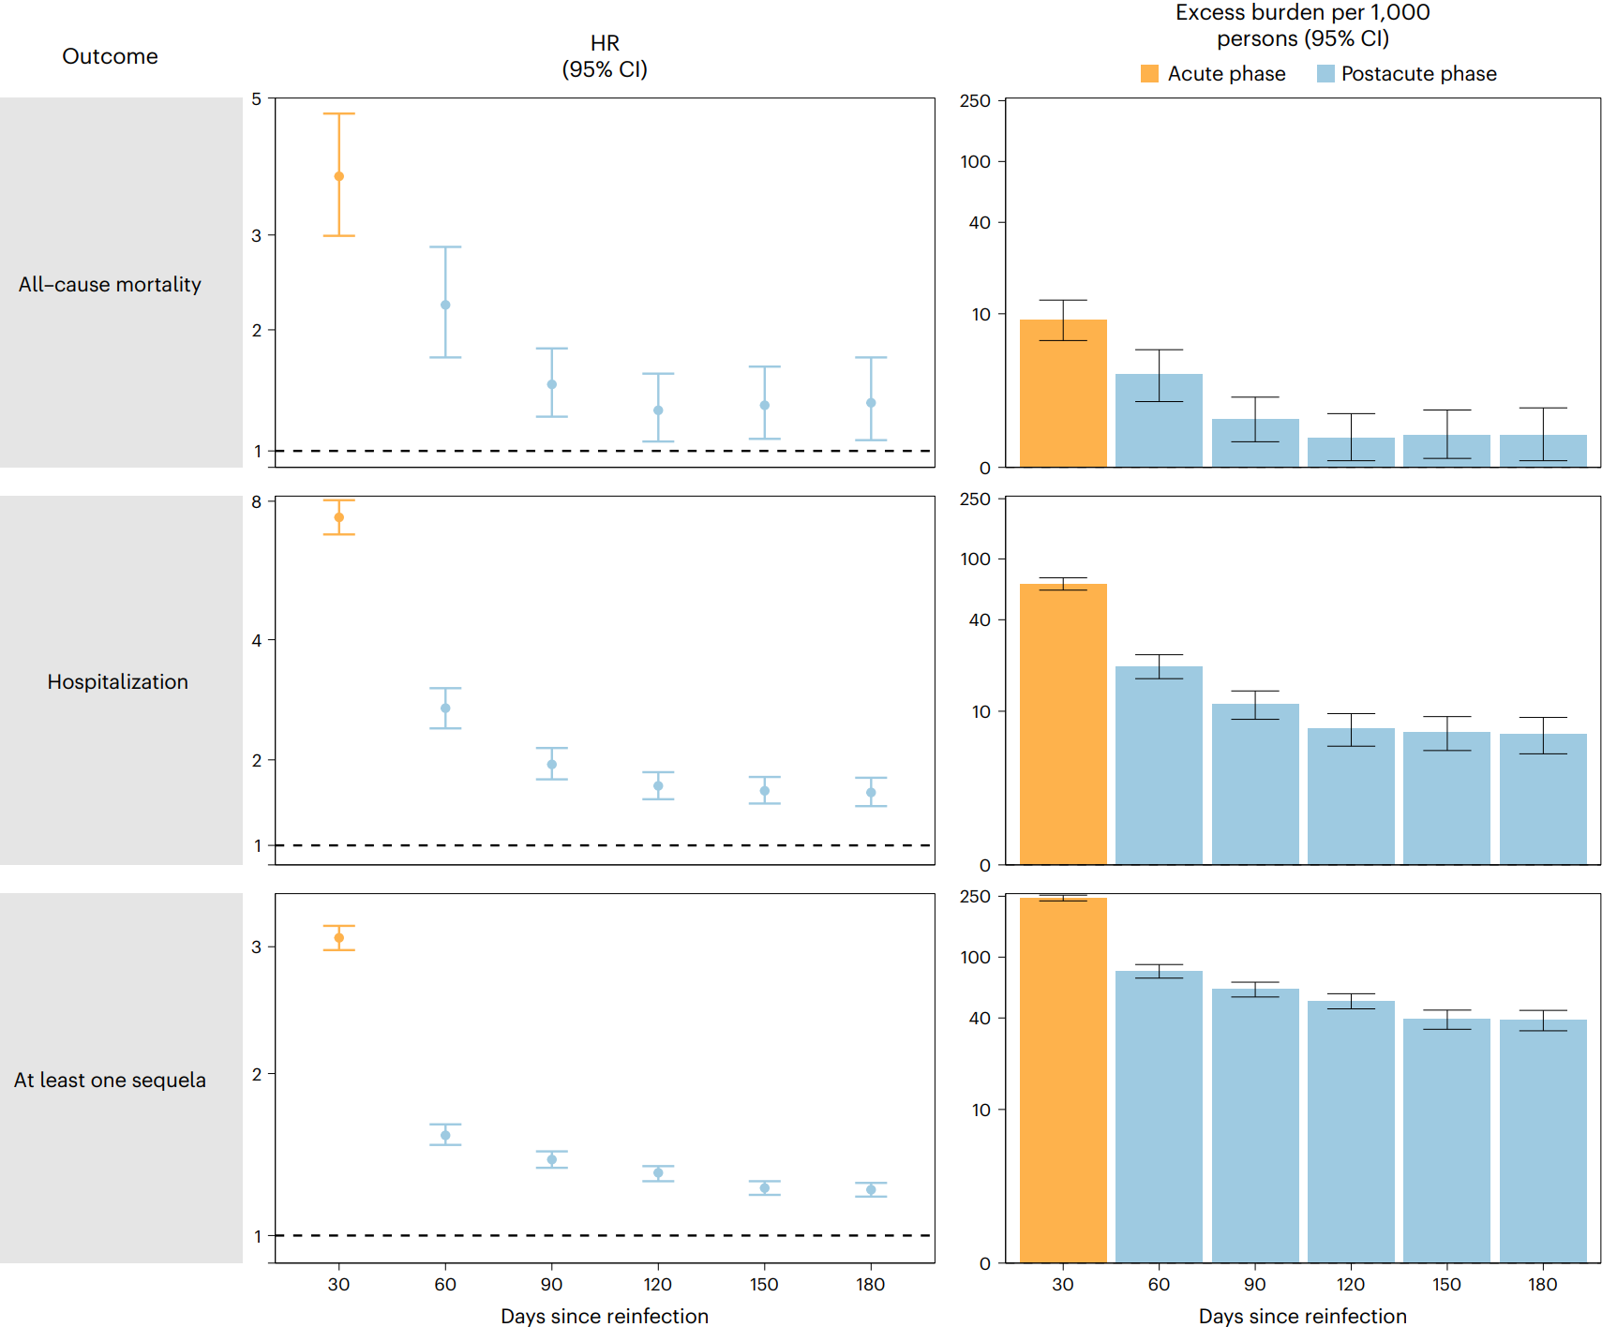
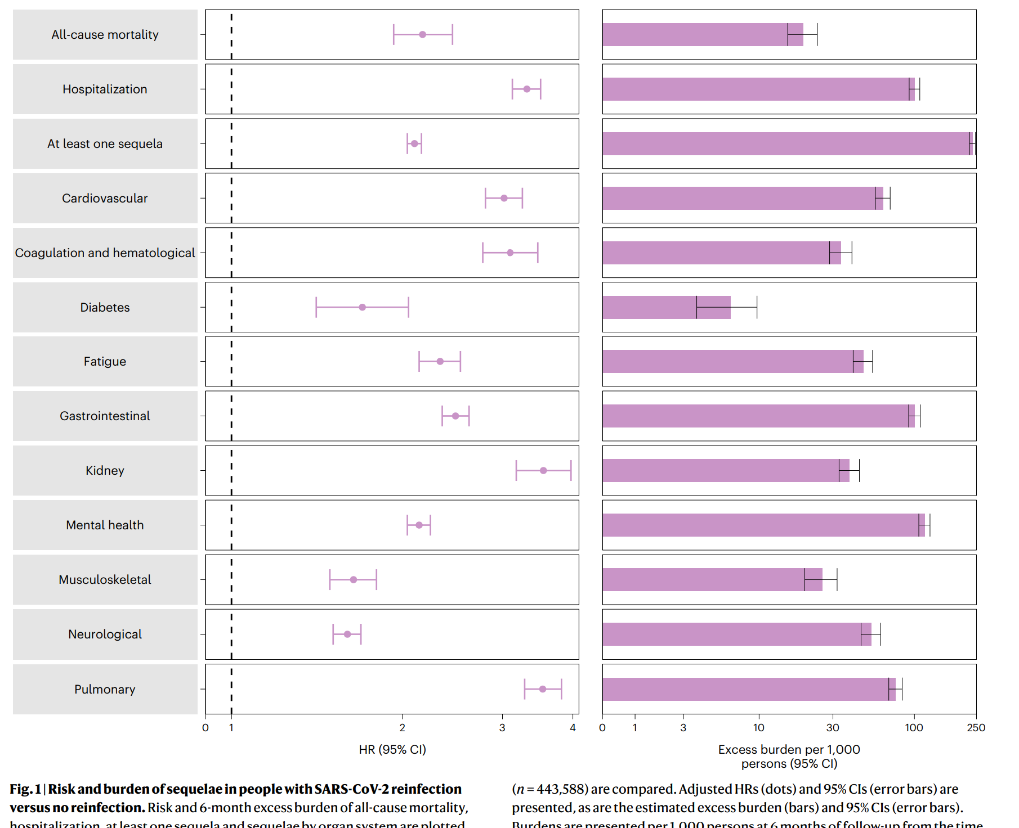
COVID-19 is NOT “A Cold or the Flu”
Risk increases with cumulative reinfections
Reinfections typically happening 5-6 months apart, can be <3 months
Notes:
https://www.nature.com/articles/s41591-022-02051-3

Slide 8
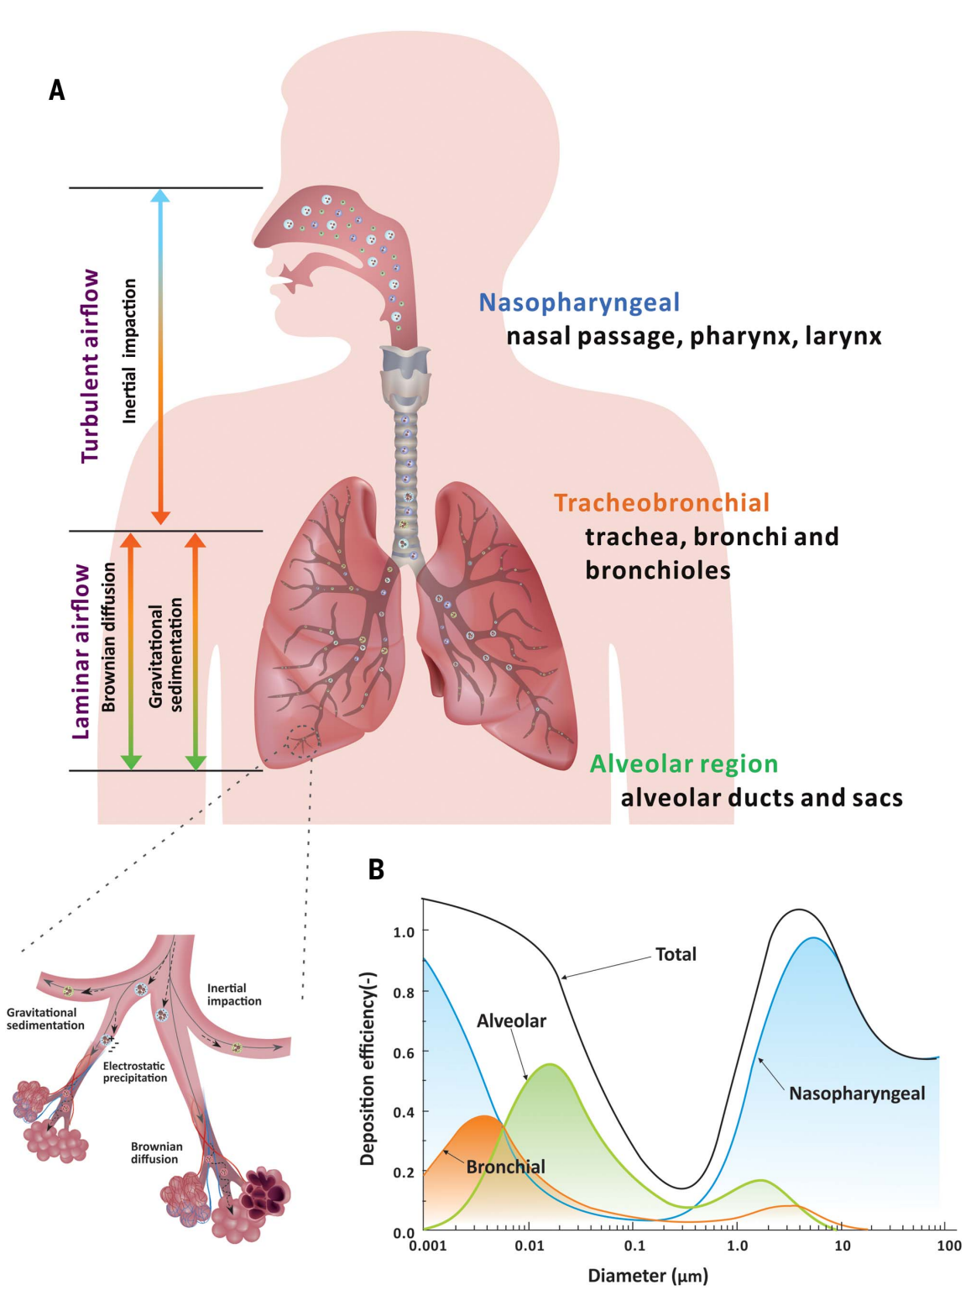
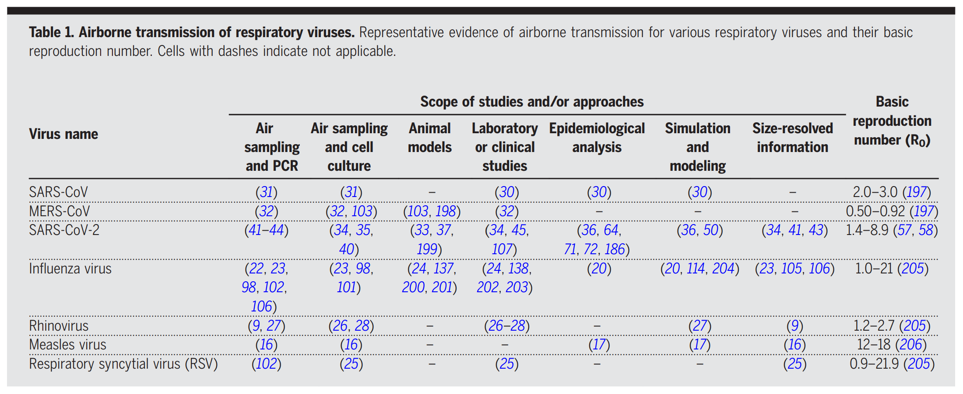
SARS-CoV-2 is Airborne #COVIDisAirborne
“Lingers in the air like smoke” (Prather) & “Purely airborne” (Jha)
Notes:
Wang, C. C., Prather, K. A., Sznitman, J., Jimenez, J. L., Lakdawala, S. S., Tufekci, Z., & Marr, L. C. (2021). Airborne transmission of respiratory viruses. Science, 373(6558), eabd9149.
https://www.science.org/doi/10.1126/science.abd9149
Sci19.com

Slide 9
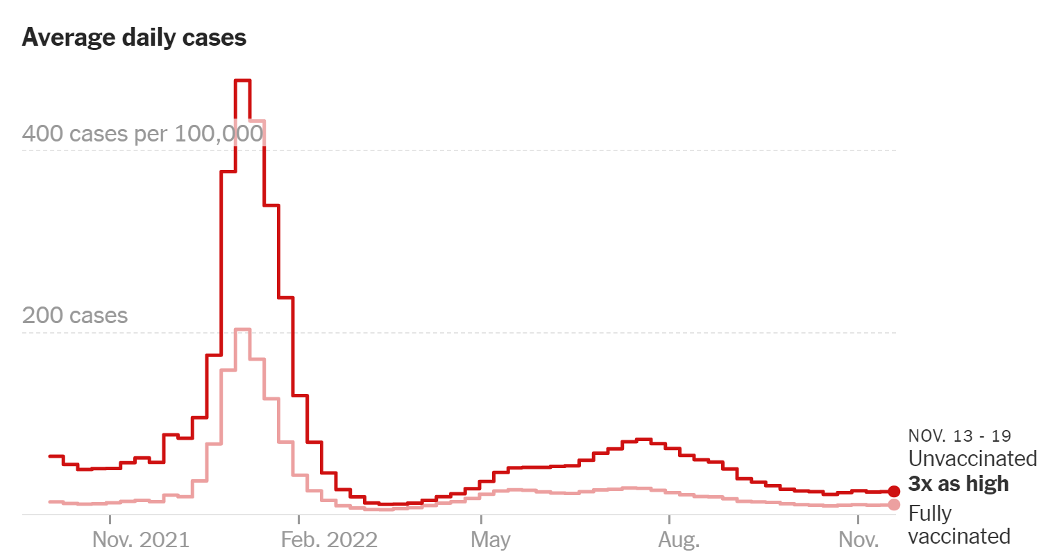
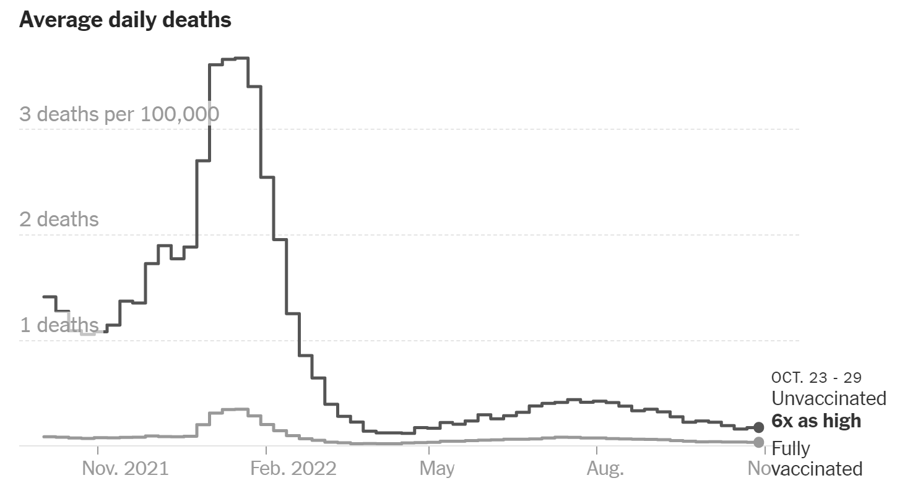
Existing Vaccines are Important but Insufficient
Reduce chances of infection, hospitalization, and death
Wane and no longer considered source control (CDC)
Insufficient reduction in Long COVID risk
Notes:
https://www.nytimes.com/interactive/2021/us/covid-cases.html
https://www.cdc.gov/coronavirus/2019-ncov/hcp/infection-control-recommendations.html
Vaccine waning:
https://www.nejm.org/doi/full/10.1056/NEJMoa2119451
https://www.nature.com/articles/s41467-022-30884-6
https://www.nejm.org/doi/full/10.1056/NEJMoa2115481
https://www.bmj.com/content/379/bmj-2022-072141
https://www.thelancet.com/journals/laninf/article/PIIS1473-3099(22)00146-3/fulltext
https://www.nature.com/articles/d41586-021-02532-4
https://www.sciencedirect.com/science/article/pii/S014067362200277X
Vaccines reduce long-COVID relative risk about 15% (e.g., from 20.0% to 18.5%):
https://www.nature.com/articles/d41586-022-01453-0

Slide 10
Multi-layered Mitigation
How to reduce the lifetime consequences of COVID-19?
Notes:
My personal adaptation of the Swiss Cheese model (pmc19.com)

Slide 11
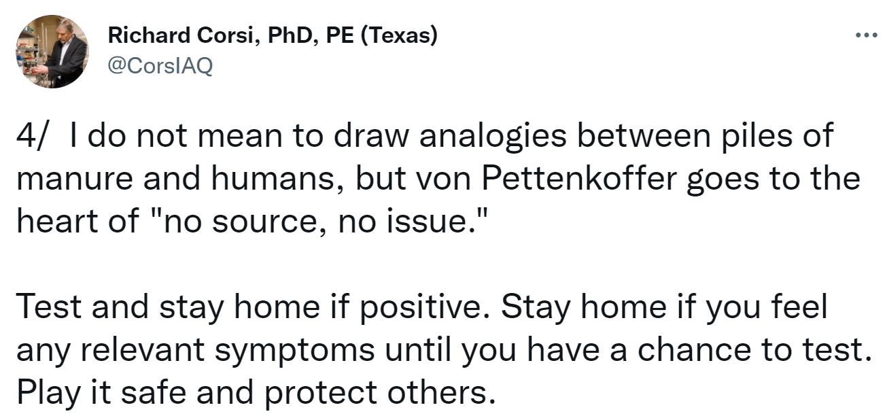
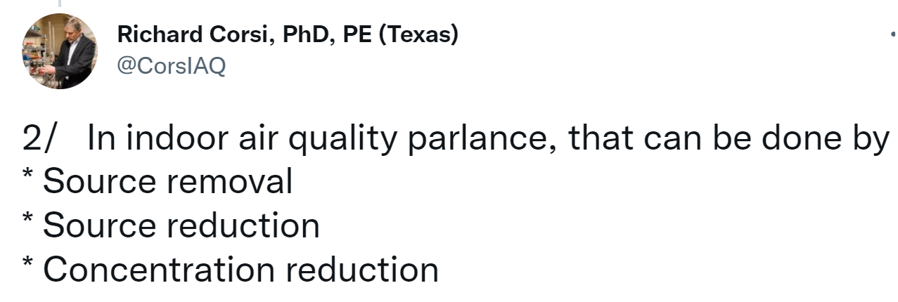
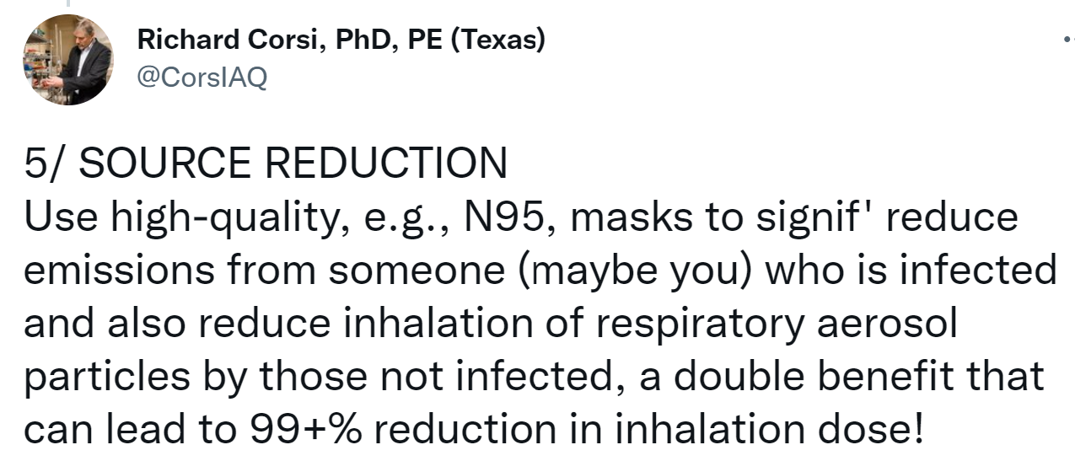
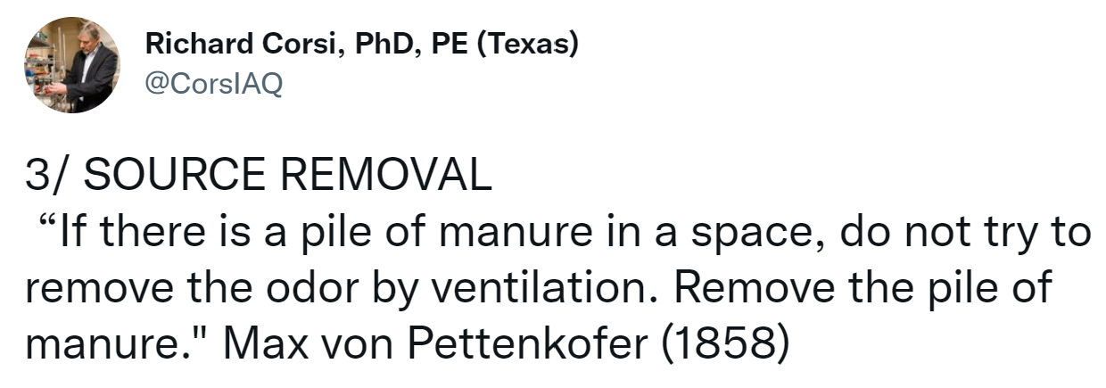
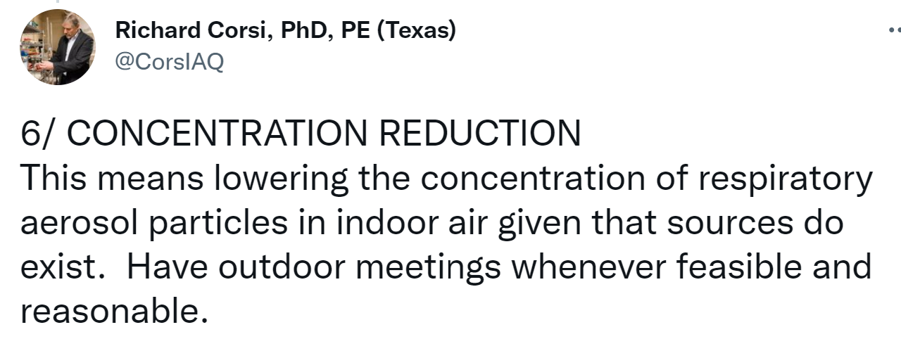
It’s Not Rocket Science
Notes:
https://twitter.com/CorsIAQ/status/1533990036294643712

Slide 12
Quarantine, Isolation, Testing
Quarantine: Stay home, N95, test for 7-10 days post-exposure
Isolate: Test for 6+ days of symptoms (PCR days 2 and 5)
Symptoms occur before infectiousness
RATs = infectiousness
PCR = case hood
2 negative RATs on diff days to end isolation
Notes:
https://twitter.com/michaelmina_lab/status/1472024457640394756

Slide 13
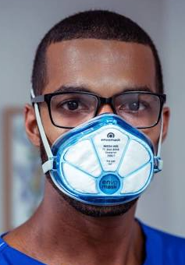
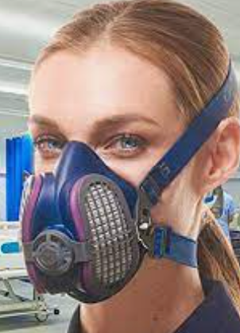
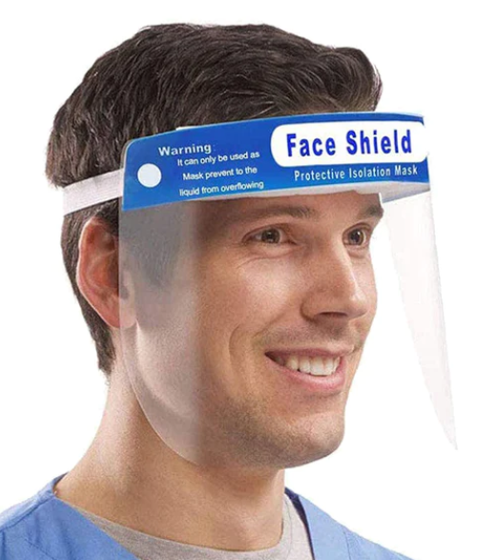
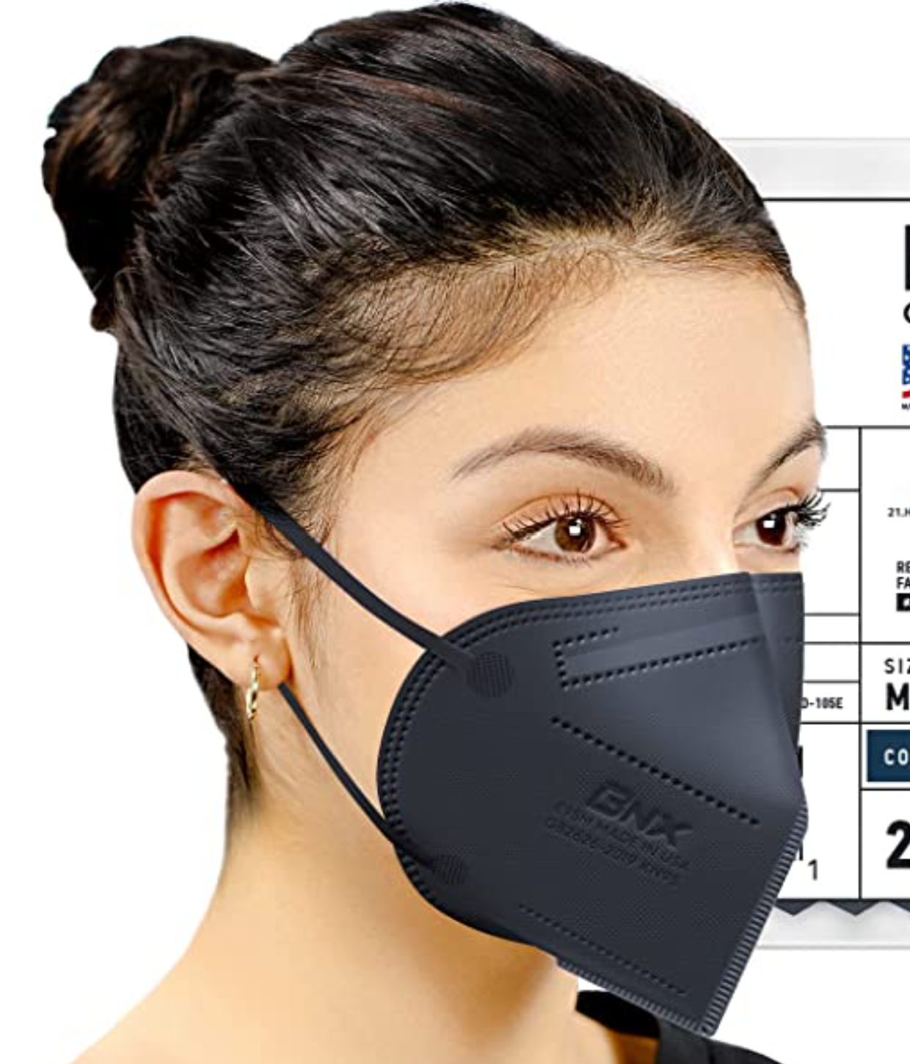
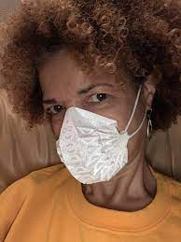
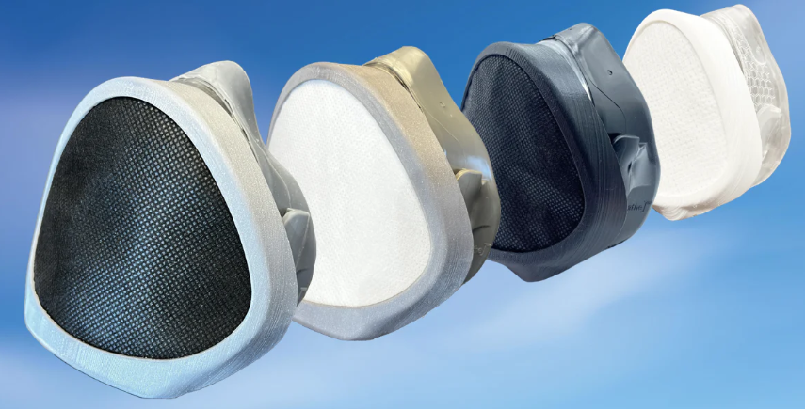
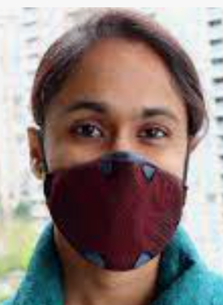
Masking – High Quality, Well-fitting, Authentic
Low Quality | Moderate Quality | High Quality | Highest Quality
Face shields, cloth masks, procedure masks, surgical masks | KN95, KF94, FFP2, and similar earloop masks | N95 and headband versions of KN95, KF94, FFP2/3, and similar masks | Elastomeric N95, N99, N100, and P100 masks, PAPR
Notes:
Video of procedure masks test (bottom left image):
https://twitter.com/jeremychrysler/status/1298354698425114624
High Quality shown:
3M Aura
Airgami
Powecom KN95 w/headstraps
Highest Quality shown:
GVS Elipse
Envo Mask
Prescient Breathe 2
Breathe99 B2 mask (went out of business, being retooled, now on pre-sale at Armbrust)
Flo Mask (large adult size, also available in small and in children’s size). I am wearing the Flo Mask, my oldest child has worn the kiddy version for >1.5 years

Slide 14
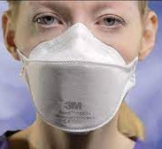
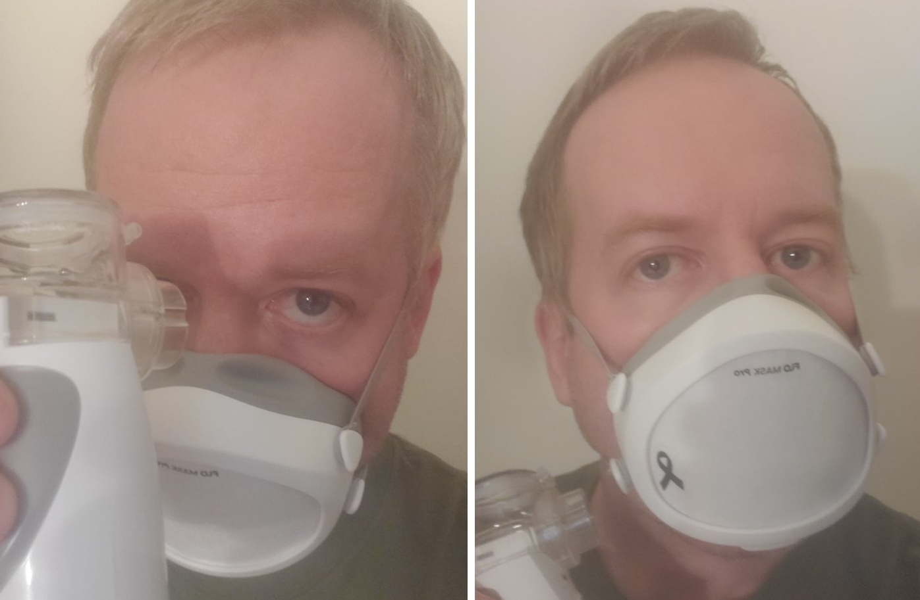
Masking – High Quality, Well-fitting, Authentic
Larger
Smaller
3M VFlex 9105 ($0.80)
3M Aura 9210 ($1.30)
Vitacore CAN99 9500 ($2.25)
3M VFlex 9105S ($0.75)
Notes:
Mask sizing based on my personal experience w/giving out thousands of masks. Aaron Collins (mask nerd) reports a similar heuristic for sizing. All else equal, start with the 3M Aura. They fit most and you can get small packs to test out from Home Depot. If too small, consider the 3M Vflex. If too big, consider the 3M Vflex S (low cost) or CAN99 (pricy).
DIY fit testing tips:
https://twitter.com/michael_hoerger/status/1604020083189219330
https://twitter.com/amandalhu/status/1523404690423095296
https://twitter.com/__philipn__/status/1523517311415513090

Slide 15
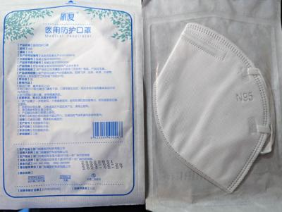
Masking – High Quality, Well-fitting, Authentic
Always buy masks directly from the manufacturer (e.g., 3M) or a trusted site:
Project N95 sells small batches at high-volume (discount) prices - https://www.projectn95.org/
Home Depot, Office Depot, Digi-Key
Compare prices after shipping costs are added, varies considerably
Avoid buying from obscure parties on Amazon, where most KN95s are fakes (CDC)
Notes:
https://www.usatoday.com/story/life/reviewed/2023/01/06/how-know-if-n-95-kn-95-face-mask-real-prevent-covid/11002606002/
https://www.nola.com/news/coronavirus/are-those-free-n95-masks-at-new-orleans-libraries-the-real-deal-it-doesnt-appear/article_a918f9d4-757a-11ec-9958-37dceef9b10c.html

Slide 16
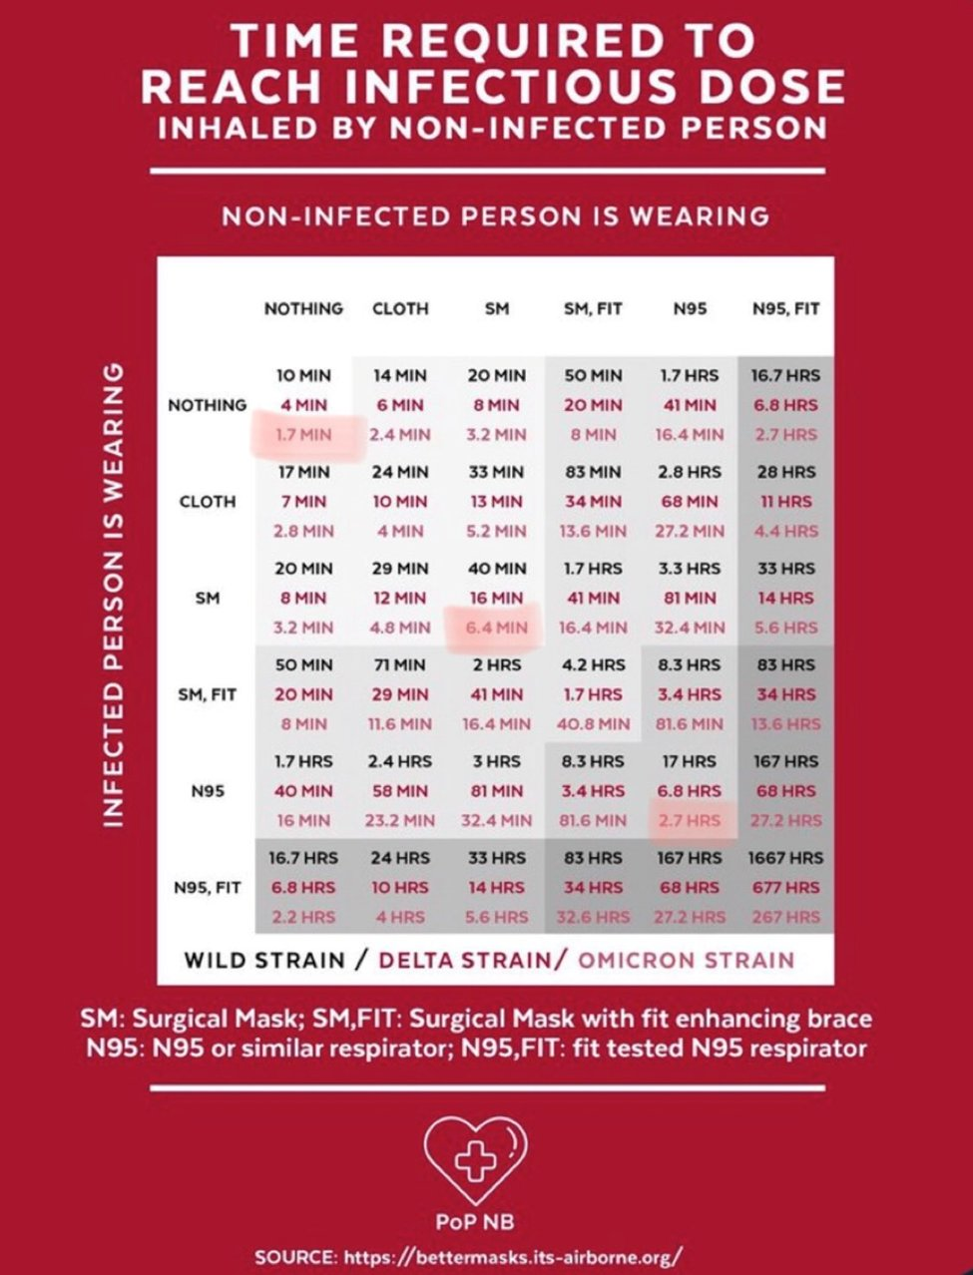
Masking – Universal Wins
Masks buy time
Better masks buy more time
Universal masking buys more time
Chart is for heuristic value
Time-to-infection depends on masks, air cleaning rates, infectiousness, body size, exercise levels, etc.
Notes:
https://bettermasks.its-airborne.org/
https://twitter.com/JuliaRaifman/status/1598675053016748035

Slide 17
Masking – Exceptions
Not everyone can mask
Children <2
Children of all ages may struggle to get a good fit
Not possible during dental, mouth, throat, and nasal exams
Not possible during meals on inpatient hospital stays
Properly masking around those who cannot mask is equitable and inclusive
Notes:
PAPR Buggy Testing:
https://engrxiv.org/preprint/view/2455
https://twitter.com/michael_hoerger/status/1547521535824519170
PAPR Buggy Designer:
https://twitter.com/RealSexyCyborg/status/1495615637204393984
FYI, you should watch Ms. Wu’s autobiography to better understand intersectionality in pandemic mitigation: https://twitter.com/RealSexyCyborg/status/1487397107124215809
Snorkel PAPR (go Ed!):
https://twitter.com/edsuom/status/1588582882372890624

Slide 18
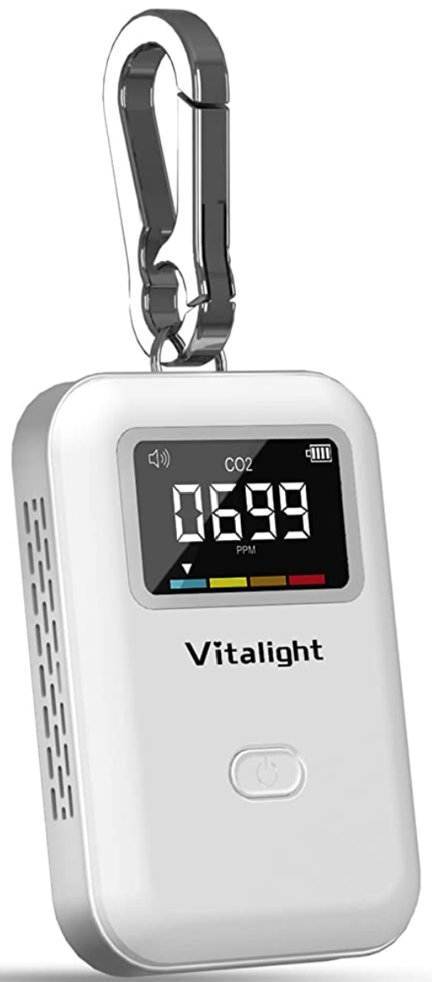
Clean Air – Ventilation
Outdoor meetings reduce but do not eliminate risk (think cigarette smoke)
HVAC (heating, ventilation, and air conditioning) systems can bring in fresh outdoor air and filter recirculated air, reducing COVID risk w/MERV-13 or better filters
Often, limited control, BUT
Can open windows
Turn HVAC from “auto” to “on”
Use CO₂ monitors
Notes:
Aranet4 CO2 monitor (many sellers available, $200-250):
https://aranet.com/products/aranet4/
Vitalight Mini CO2 Detector, $40
https://www.amazon.com/Vitalight-Detector-Quality-Lightweight-Anywhere/dp/B0B3J3757C

Slide 19
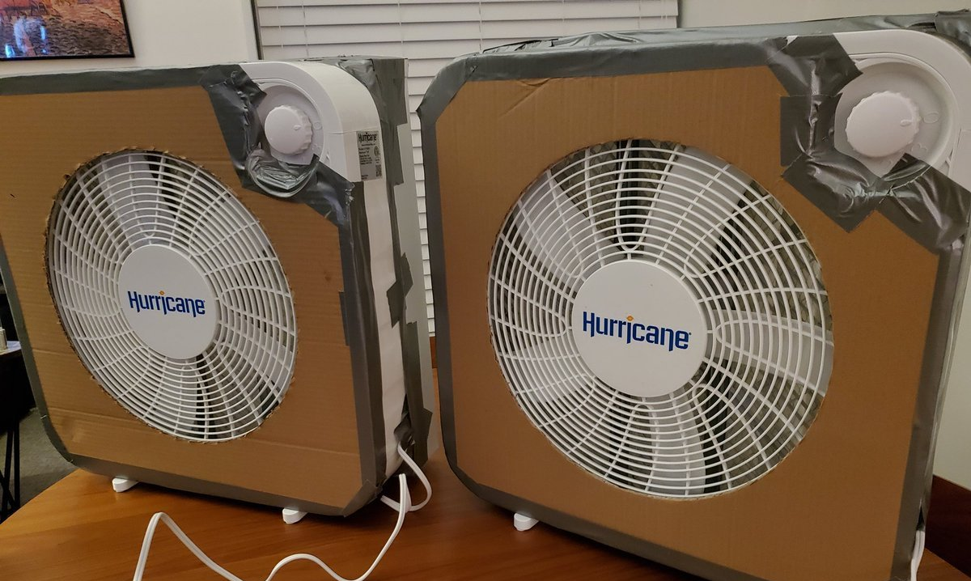
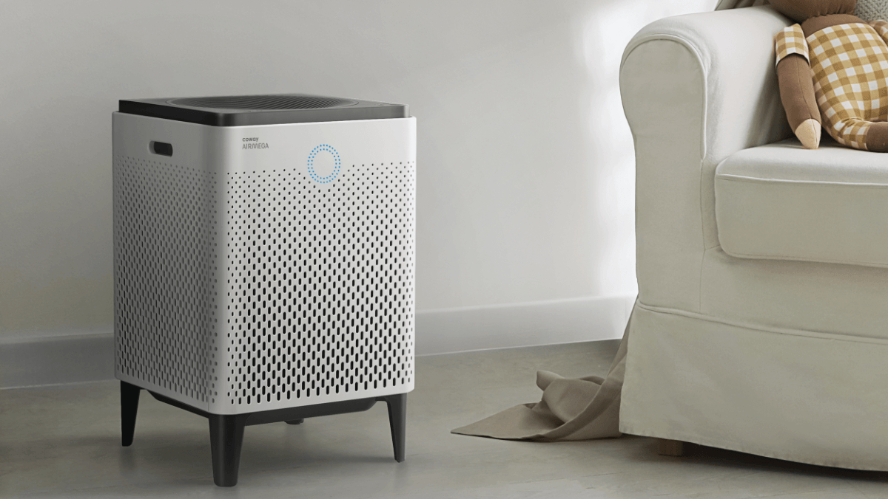
Clean Air – Filtration #CorsiRosenthalBox
HEPA filters can remove viruses, allergens, dust, and smoke from the air
DIY air cleaners work similarly, slightly louder, much lower cost
#CorsiRosenthalBox
Notes:
Twitter: #corsirosenthalbox
Overview and Instructions
https://www.patientknowhow.com/safe.html
https://cleanaircrew.org/box-fan-filters/
Peer-reviewed Publications on DIY Air Cleaners:
Srikrishna, D. (2022). Can 10× cheaper, lower-efficiency particulate air filters and box fans complement High-Efficiency Particulate Air (HEPA) purifiers to help control the COVID-19 pandemic?. Science of the Total Environment, 155884.
Dal Porto, R., Kunz, M. N., Pistochini, T., Corsi, R. L., & Cappa, C. D. (2022). Characterizing the performance of a do-it-yourself (DIY) box fan air filter. Aerosol Science and Technology, 56(6), 564-572.
News Articles
https://www.dallasnews.com/news/2022/08/23/how-a-100-box-is-changing-the-way-people-protect-themselves-against-coronavirus/
https://www.sactownmag.com/viral-sensation-corsi-rosenthal-boxes/
https://www.latimes.com/california/story/2022-07-20/diy-push-to-rid-indoor-air-of-covid
https://www.msn.com/en-us/health/wellness/how-a-100-box-is-changing-the-way-people-protect-themselves-against-coronavirus/ar-AA10Zj1a?ocid=weather-verthp-feeds
https://www.news-gazette.com/coronavirus/coronavirus-response-health-district-giving-away-homemade-air-purifiers/article_9e68b639-10fe-5763-9688-ac27301b9005.html
https://www.ucdavis.edu/news/checking-chancellor-may-planning-ahead
https://www.smithsonianmag.com/innovation/homemade-air-purifier-thats-been-saving-lives-during-covid-19-pandemic-180979681/
https://www.sciencenews.org/article/covid-home-coronavirus-isolation-filter-transmission
https://news.asu.edu/20220815-asu-receives-first-cryptocurrency-gift-support-clean-air-work
https://time.com/6206343/schools-ventilation-covid-19-air-quality/
https://edmontonjournal.com/opinion/columnists/opinion-better-protecting-schools-from-covid-is-within-reach
https://www.wfaa.com/article/news/health/coronavirus/diy-air-purifier-reduce-spread-airborne-virus-particles-how-to-build-it/287-51073bac-8dca-4de7-87b9-55cf1219ff5b
https://www.fastcompany.com/90727987/how-this-simple-nondescript-box-has-saved-lives-during-the-pandemic
https://news.yahoo.com/kids-school-needs-better-ventilation-143802840.html
https://www.statepress.com/article/2022/02/community-students-build-corsi-rosenthal-air-filter-boxes
https://www.insauga.com/anyone-in-mississauga-can-get-a-custom-corsi-rosenthal-box-thanks-to-teen-engineer/
https://today.umd.edu/can-a-little-duct-tape-help-fix-the-pandemic
https://www.cbc.ca/radio/thecurrent/the-current-for-jan-6-2022-1.6305961/meet-the-ontario-teen-building-diy-air-purifiers-for-seniors-and-small-businesses-1.6307667
https://www.browndailyherald.com/article/2021/11/school-of-public-health-installs-cube-air-cleaners-as-additional-covid-19-prevention-measure

Slide 20
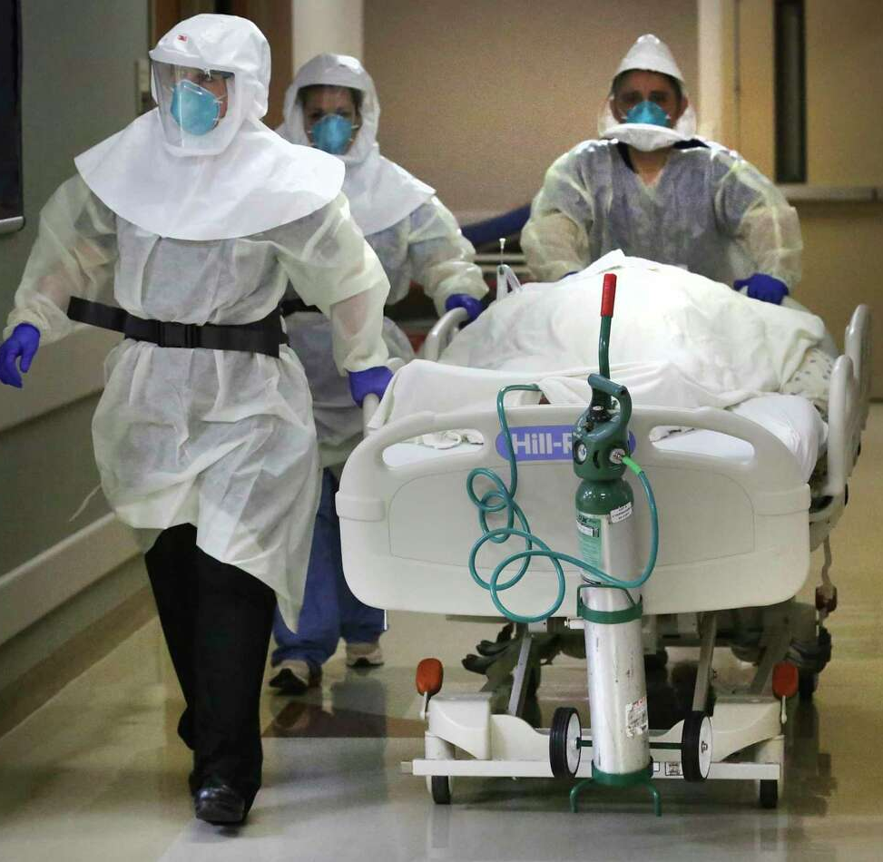
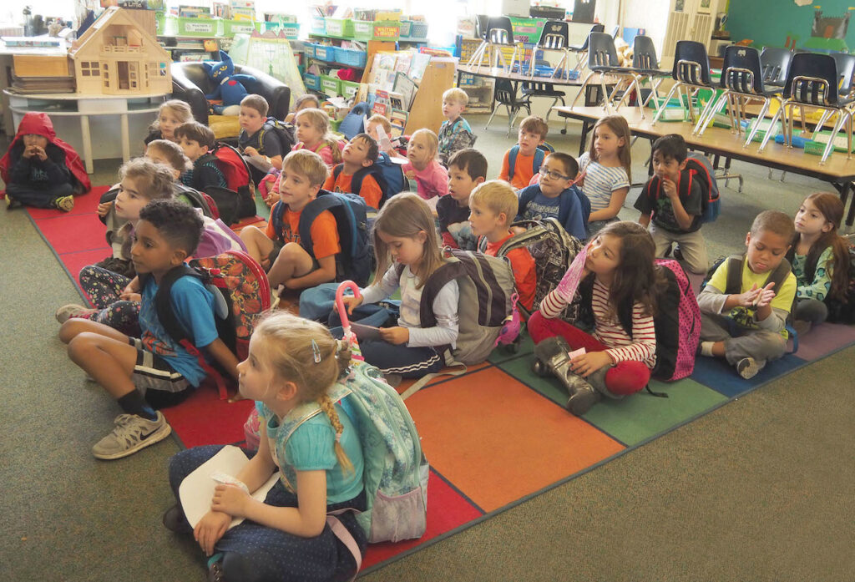
Clean Air – Standards
No universal COVID standards for homes, schools, and businesses
1 case
N95/PAPR
12-20 ACH
2-3 cases
No masks
1-3 ACH
COVID Unit
School
If many indoor places are similar to or more dangerous than COVID units, we should seek universal high-quality masking indoors with >12 ACH targets

Slide 21
When COVID Strikes Home
In-home spread is NOT “written in the stars” https://cleanaircrew.org/someone-in-my-home-has-covid-how-do-we-isolate-safely/
Paxlovid can reduce illness burden substantially, comes with manageable risk of rebound with onset by approximately day 15
Most common anecdotal advice – rest, rest, rest
Monitor for unusual symptoms during subsequent months, such as changes in heart rate, seek primary/urgent care first
Long COVID clinics exist, but long wait times and often no silver bullets https://www.survivorcorps.com/pccc
Notes:
Reducing in-home spread:
https://cleanaircrew.org/someone-in-my-home-has-covid-how-do-we-isolate-safely/
Paxlovid benefits:
https://www.nejm.org/doi/full/10.1056/NEJMoa2118542
https://www.bmj.com/content/377/bmj.o1037
Navigating Paxlovid rebound:
https://www.nejm.org/doi/full/10.1056/NEJMc2206449
https://twitter.com/michael_hoerger/status/1567751328918638595
Long COVID clinics:
https://www.survivorcorps.com/pccc

Slide 22
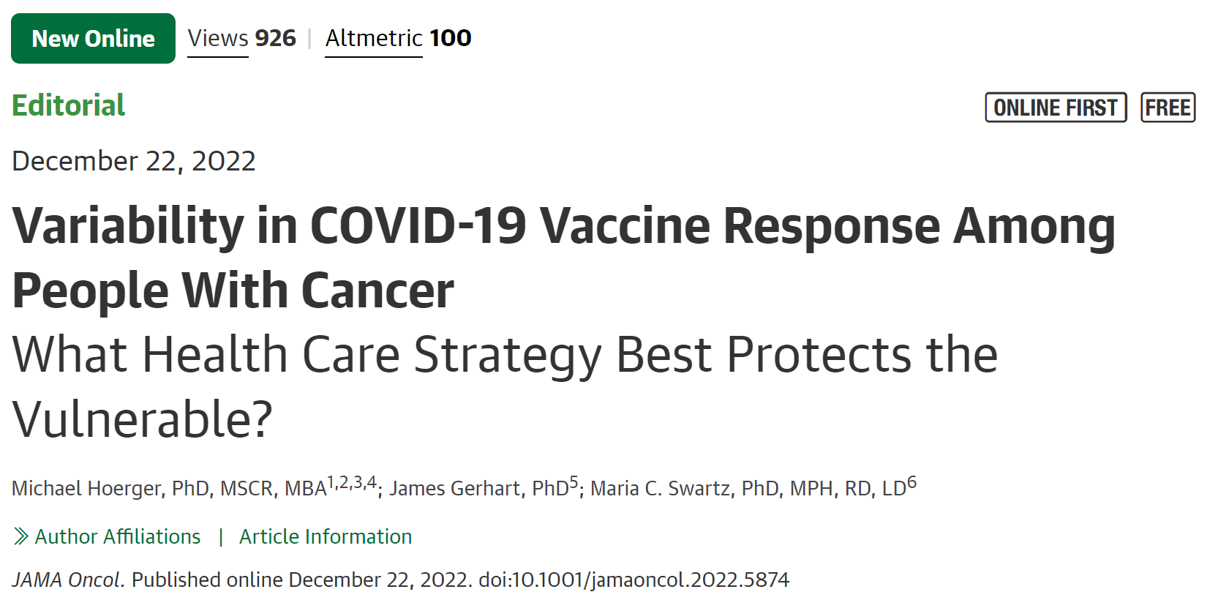
Vulnerability and Inclusivity
An inclusive society provides equitable opportunities to people who are known to be vulnerable to COVID-19
An inclusive society also supports people with unknown vulnerabilities to COVID-19, and that may be you
Regression models are imperfect
Vulnerabilities change, e.g., reinfections, new vaccines, treatments, and variants
Many important outcomes beyond hospitalization and death
Notes:
https://pubmed.ncbi.nlm.nih.gov/36547943/

